Slide 1
Discussion items – Sep-9th
Feature importances across
WHONDRS
HYDROSHEDS
STREAMSTATS
EPA-Waters-Catchment
EPA-Waters-Watershed

Slide 2
Feature importance among WHONDRS variables
Metric/Descriptor of intrinsic variables
Species richness
This is estimated from the sample site data
Metrics/Descriptors of extrinsic variables
WHONDRS metadata for these sites
Surface water temperature
Dissolved oxygen
pH
Stream order
Feature importances → X: (all_samples, n_features); Y: (all_samples,)
Pearson correlation
Spearsman correlation
F-test
Mutual information (MI)
Random Forest (RF) with n_trees = 100
SHAPley values (based on RF model)

Slide 3
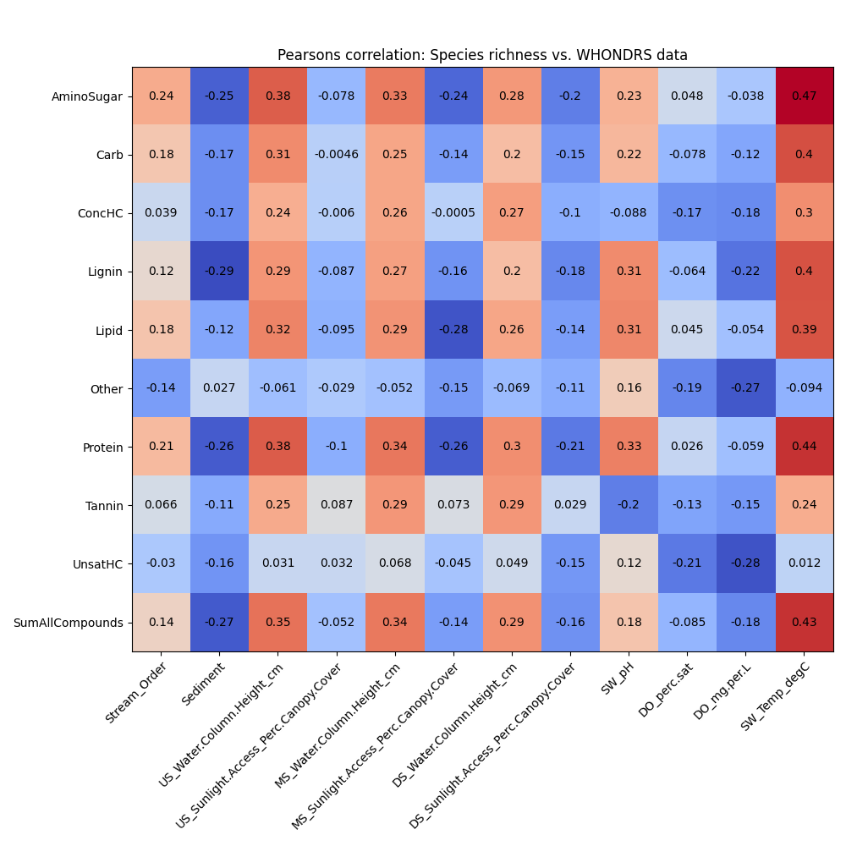
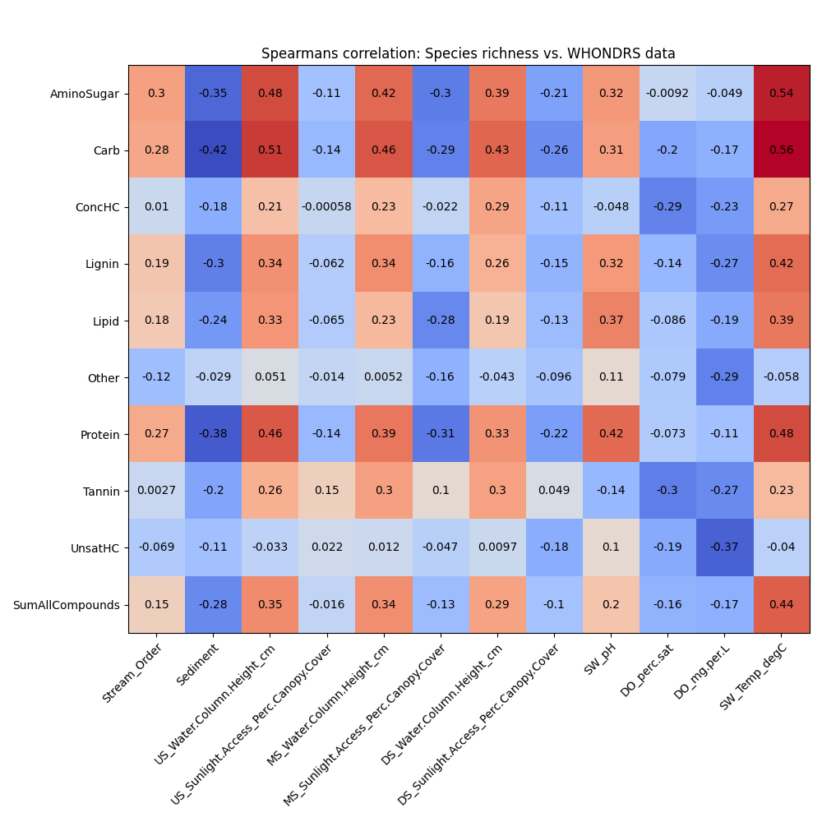
Feature importances – Pearsons and spearsman correlations (WHONDRS)

Slide 4
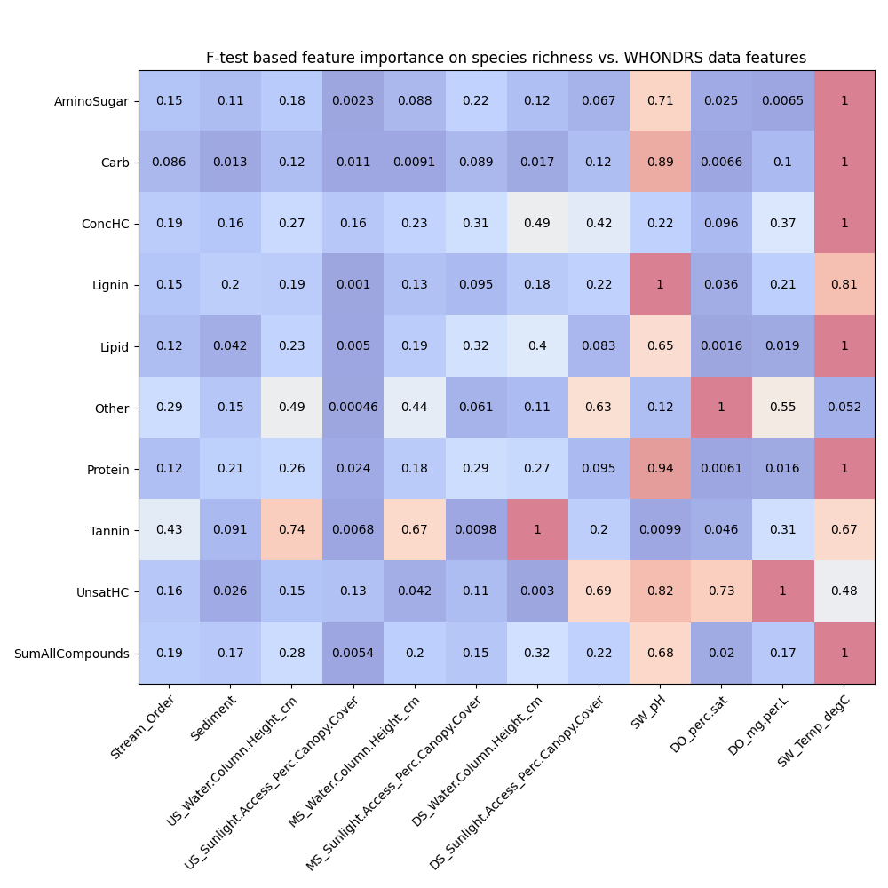
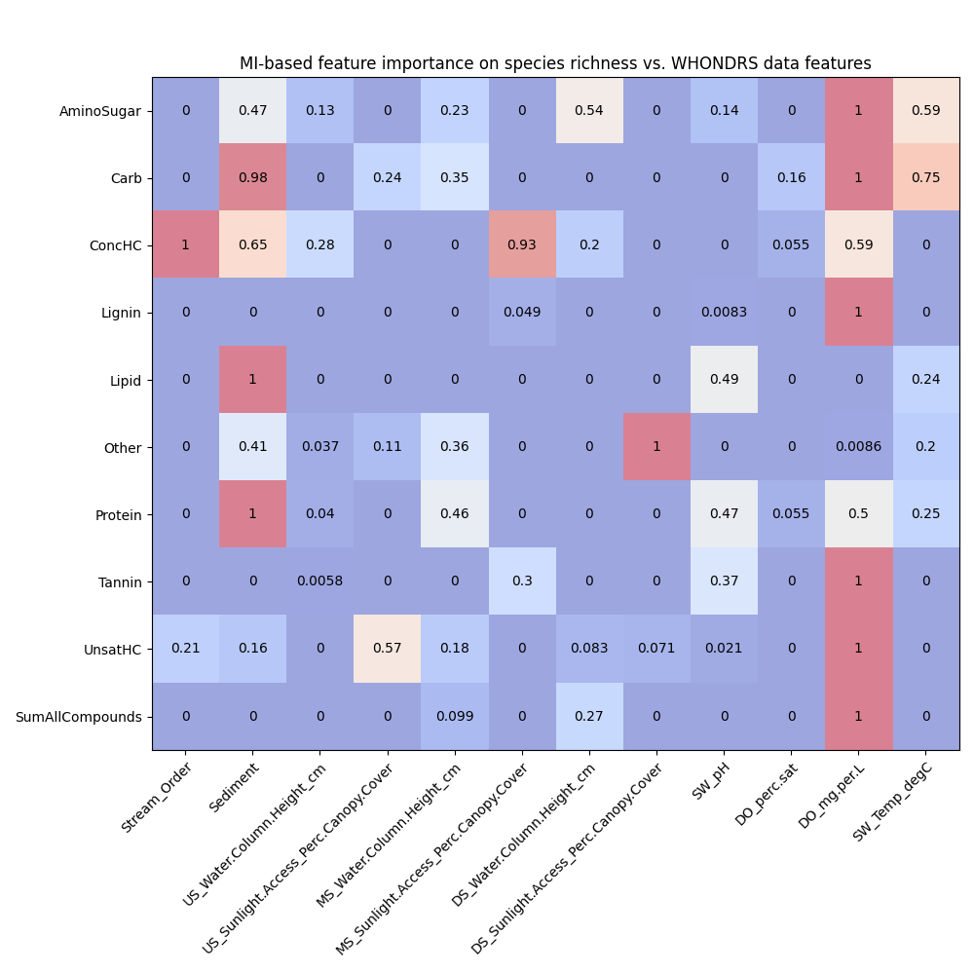
Feature importances using F-test and Mutual Information (WHONDRS)

Slide 5
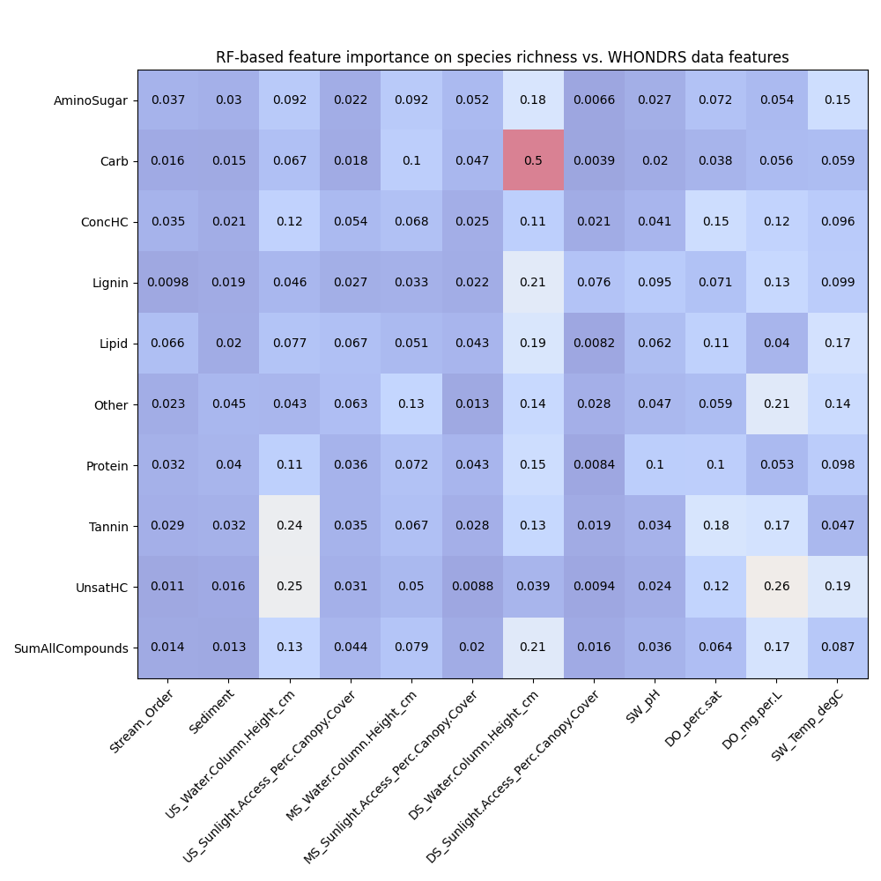
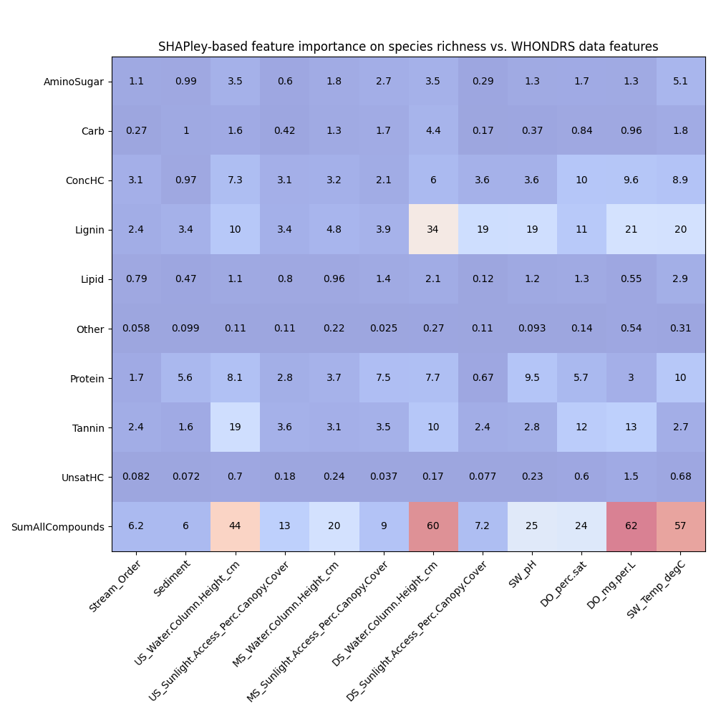
Feature importances using RF and SHAPley (WHONDRS)

Slide 6
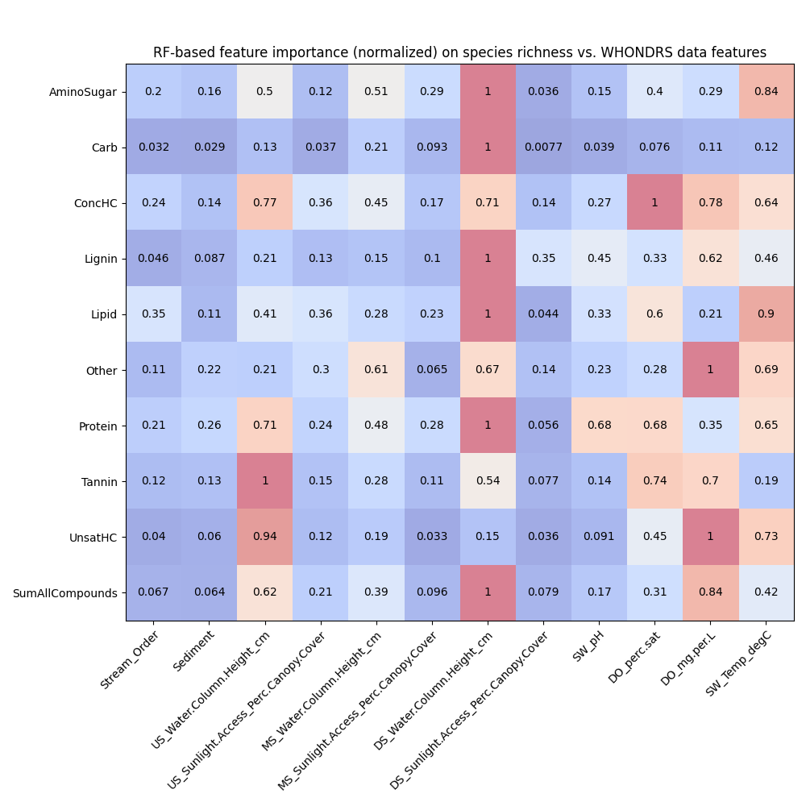
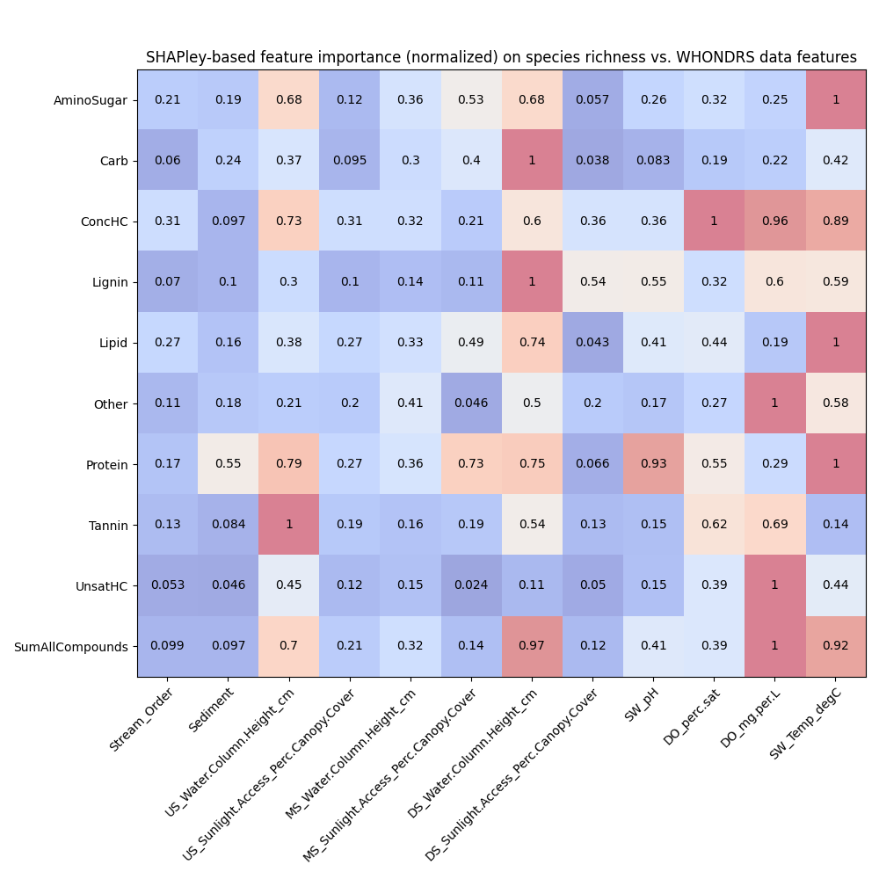
Feature importances using RF and SHAPley normalized (WHONDRS)

Slide 7
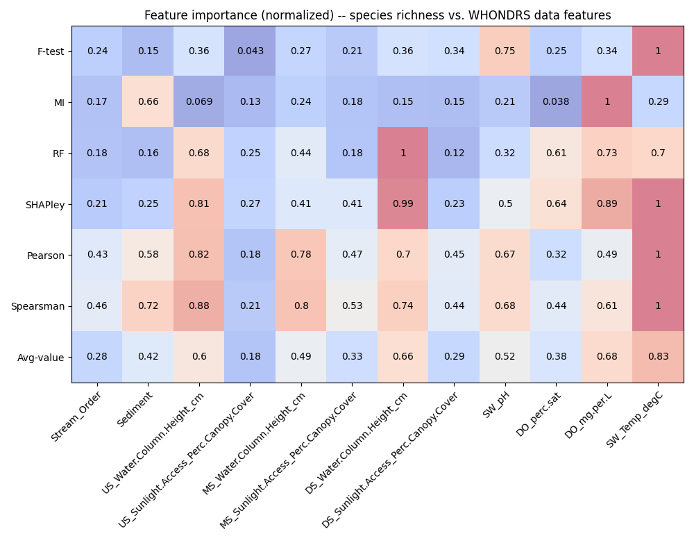
Feature importances among WHONDRS variables
Behavior threshold for feature importance = 0.5
Min requirement = One feature shows a value > 0.5 among the feature importance methods
SW_Temp_degC -- Water temperature at 50% depth at downstream sampling location
DO_mg.per.L -- Dissolved oxygen at 50% depth at downstream sampling location
DO_perc.sat -- Dissolved oxygen at 50% depth at downstream sampling location
SW_pH -- pH value from colorimetric pH strip
DS_Water.Column.Height_cm -- Height of water column at downstream sampling location
MS_Water.Column.Height_cm -- Height of water column at midstream sampling location
US_Water.Column.Height_cm -- Height of water column at upstream sampling location
Sediment -- Dominant sediment type. From provided controlled vocabulary
Notes:
Citations for these statistical tests
Explain each of them and about what we discussed today
PCA analysis across WHONDRS, HydroSheds, StreamStats, and EPAwaters – On the extrinsic variables (grouping of variables – Local variables and landscape variables)
Landscape variables – HydroSheds, StreamStats, and EPAWatersheds
What a scaling plot would look like?

Slide 8
Feature importance among HYDROSHEDS variables
Metric/Descriptor of intrinsic variables
Species richness
This is estimated from the sample site data
Metrics/Descriptors of extrinsic variables
HYDROSHEDS data for these sites
Natural discharge
River area/volume
ET
Air temperature
Feature importances → X: (all_samples, n_features); Y: (all_samples,)
Pearson correlation
Spearsman correlation
F-test
Mutual information (MI)
Random Forest (RF) with n_trees = 100
SHAPley values (based on RF model)

Slide 9
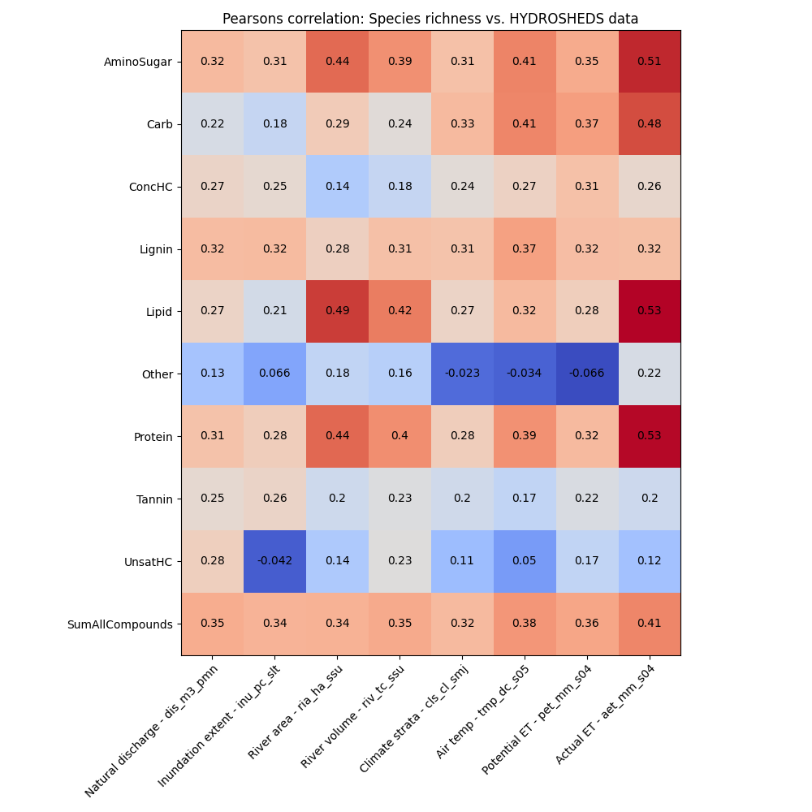
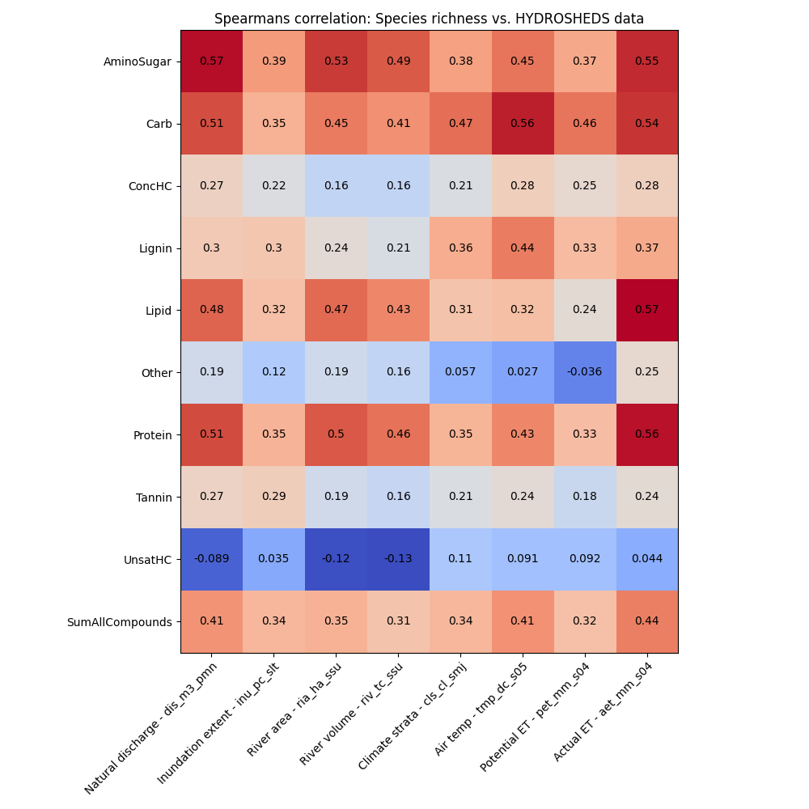
Feature importances – Pearsons and spearsman correlations (HYDROSHEDS)

Slide 10
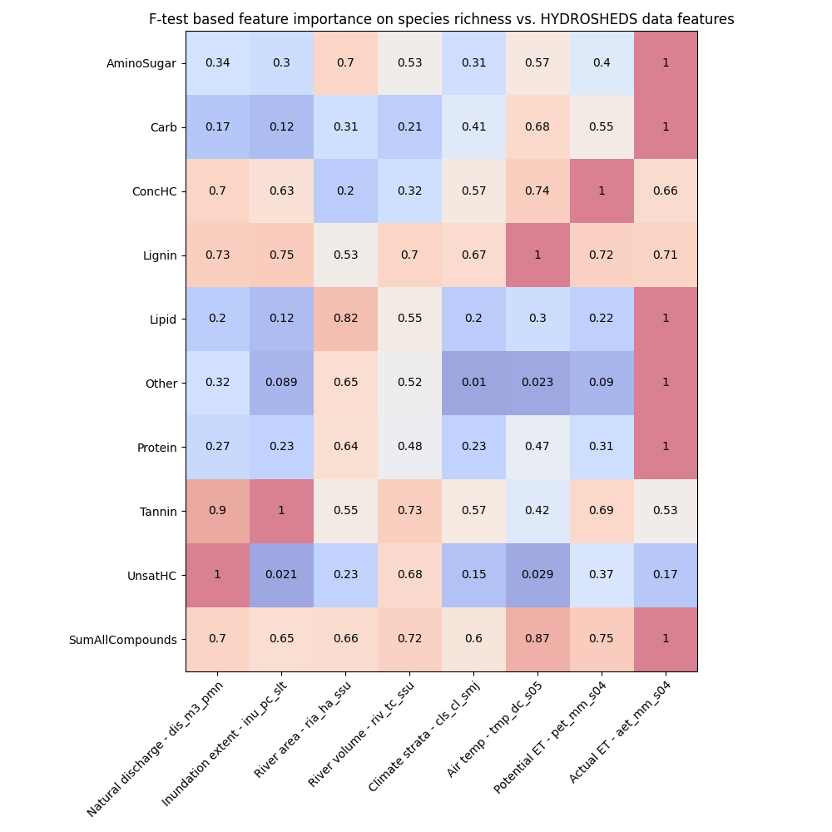
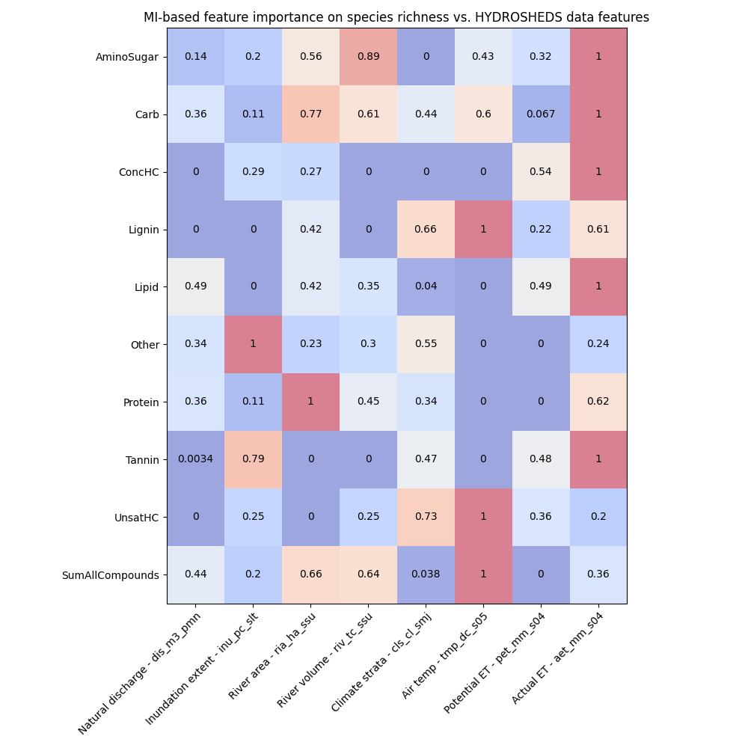
Feature importances using F-test and Mutual Information (HYDROSHEDS)

Slide 11
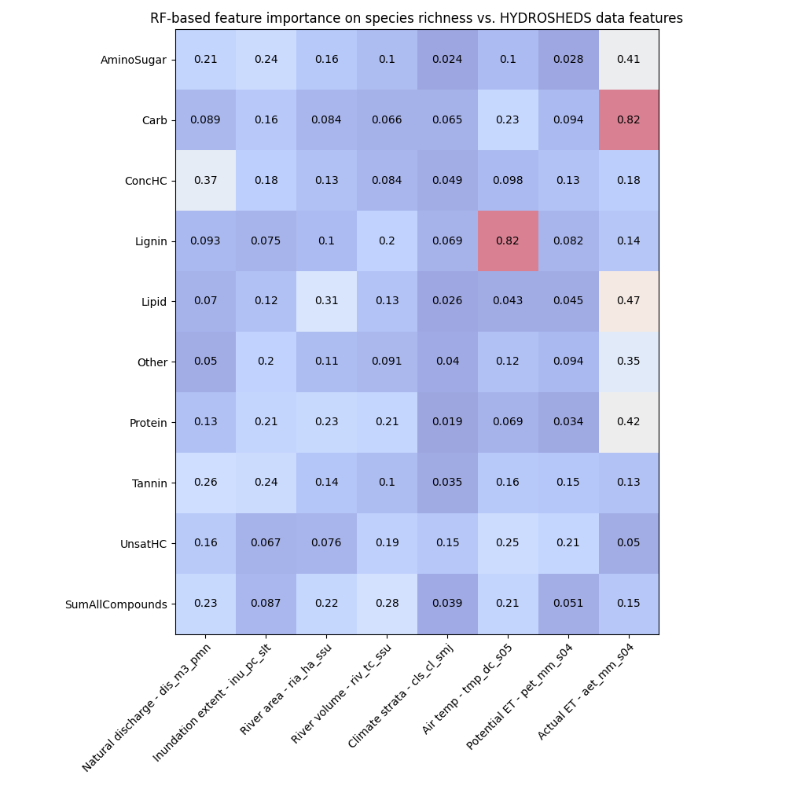
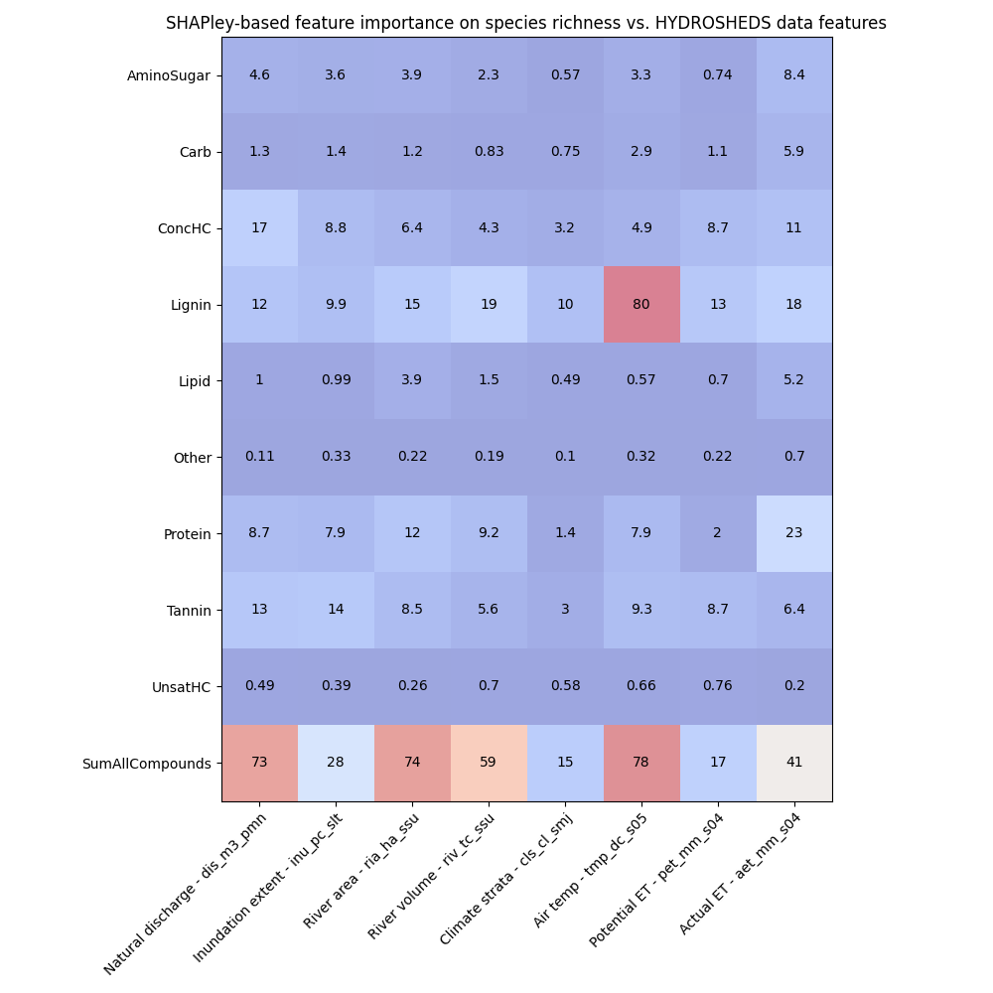
Feature importances using RF and SHAPley (HYDROSHEDS)

Slide 12
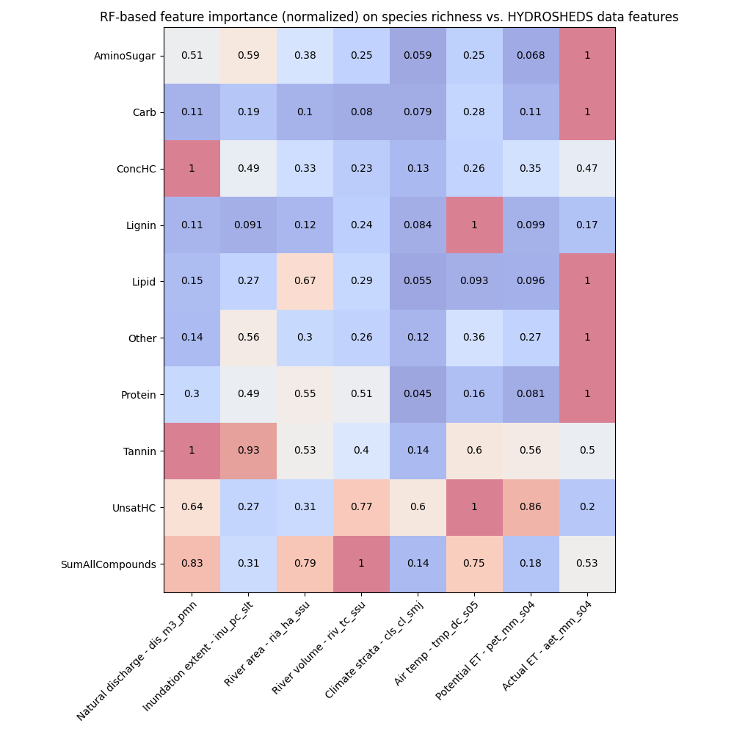
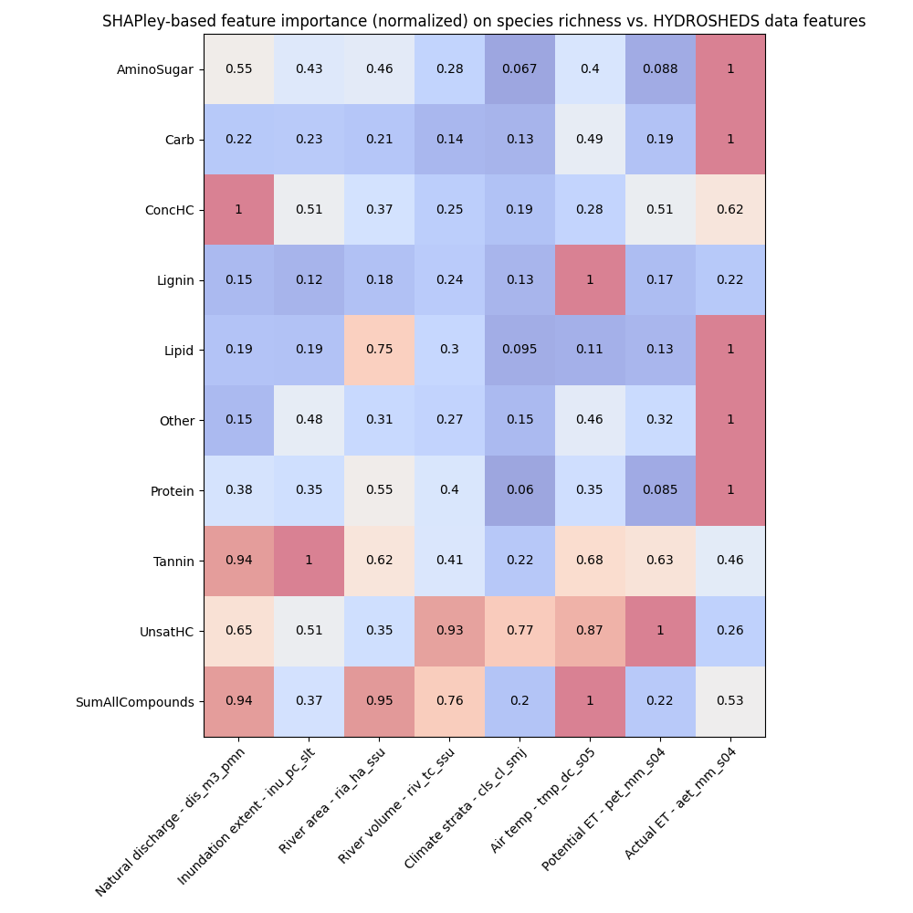
Feature importances using RF and SHAPley normalized (HYDROSHEDS)

Slide 13
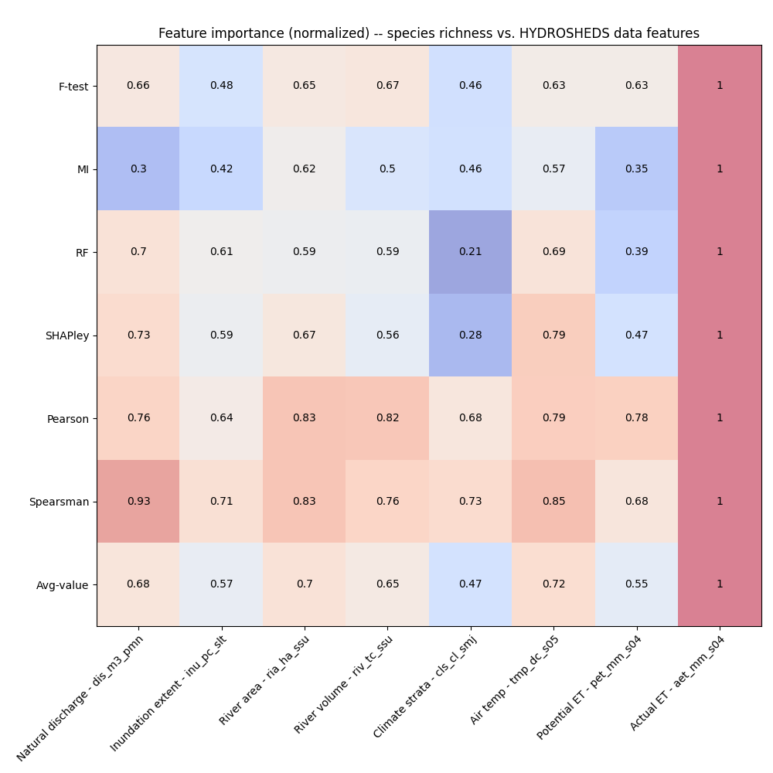
Feature importances among HYDROSHEDS variables
Behavior threshold for feature importance = 0.5
Min requirement = One feature shows a value > 0.5 among the feature importance methods
Actual ET
Potential ET
Air temperature
Climate strata
River volume
River area
Inundation extent
Natural discharge
Notes:
Citations for these statistical tests
Explain each of them and about what we discussed today
PCA analysis across WHONDRS, HydroSheds, StreamStats, and EPAwaters – On the extrinsic variables (grouping of variables – Local variables and landscape variables)
Landscape variables – HydroSheds, StreamStats, and EPAWatersheds
What a scaling plot would look like?

Slide 14
Feature importance among StreamStats variables
Metric/Descriptor of intrinsic variables
Species richness
This is estimated from the sample site data
Metrics/Descriptors of extrinsic variables
StreamStats data for these sites
Latitude
Drainage area
Elevation
Precipitation
Feature importances → X: (all_samples, n_features); Y: (all_samples,)
Pearson correlation
Spearsman correlation
F-test
Mutual information (MI)
Random Forest (RF) with n_trees = 100
SHAPley values (based on RF model)

Slide 15
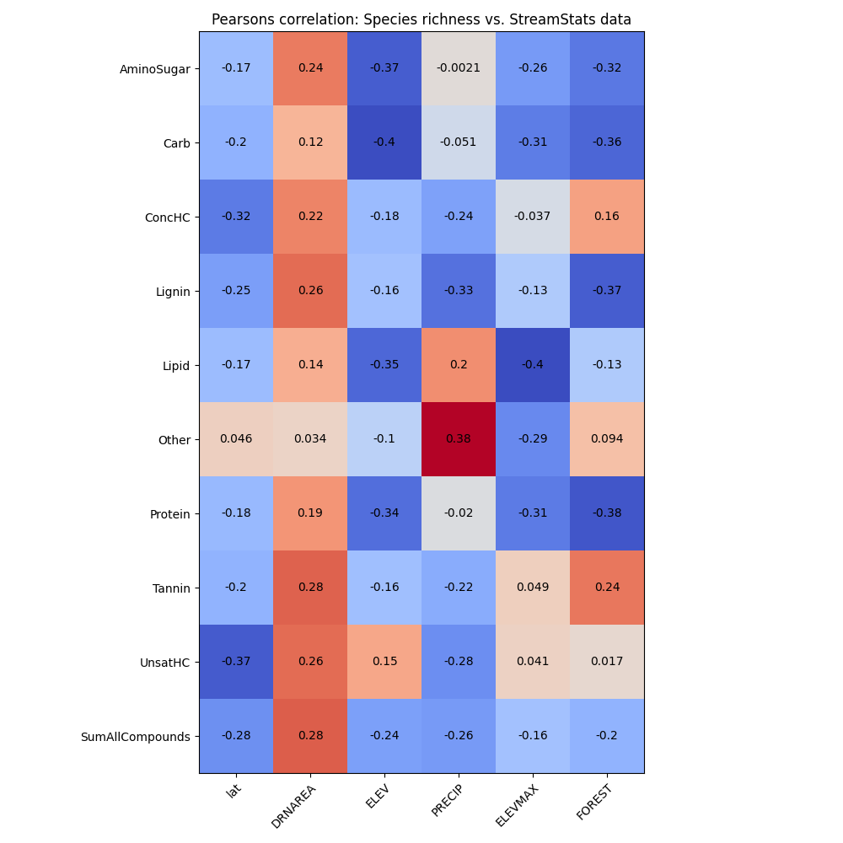
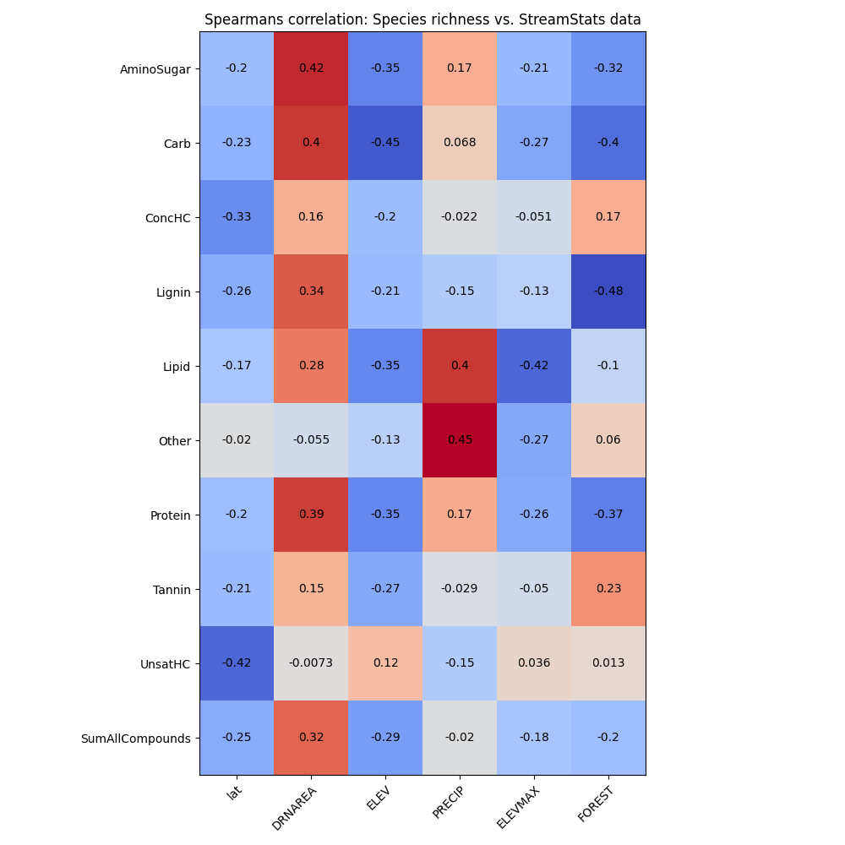
Feature importances – Pearsons and spearsman correlations (StreamStats)

Slide 16
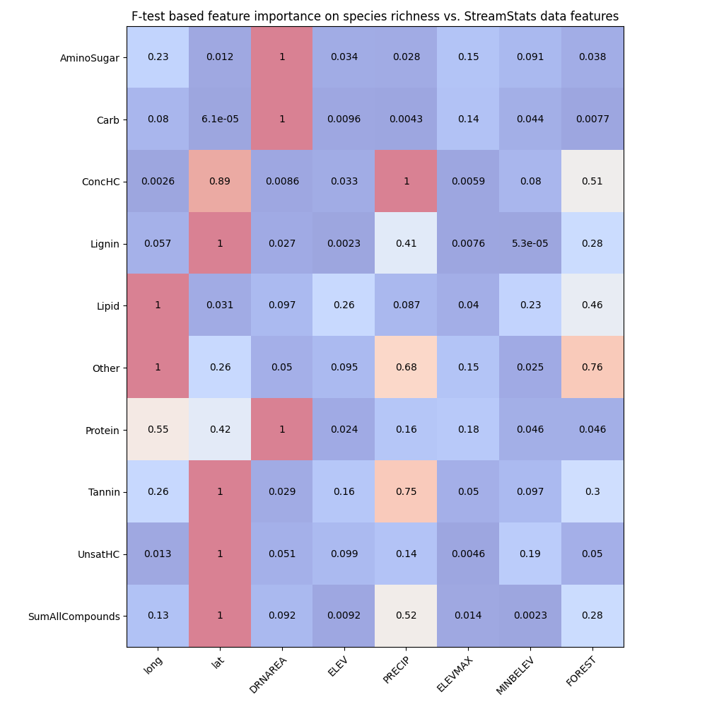
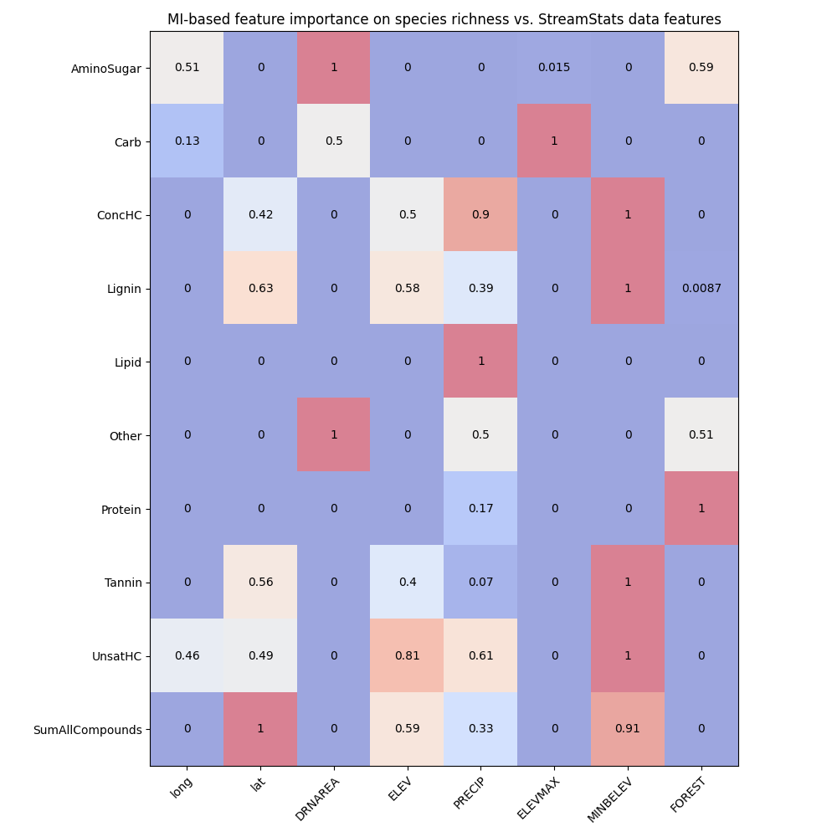
Feature importances using F-test and Mutual Information (StreamStats)

Slide 17
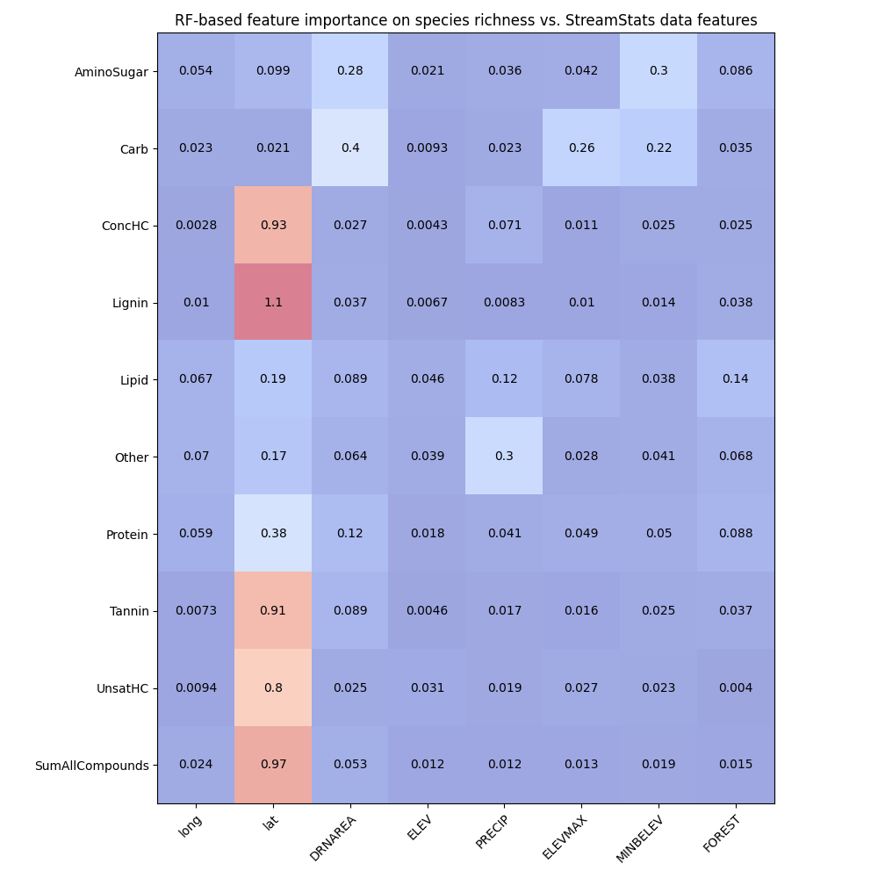
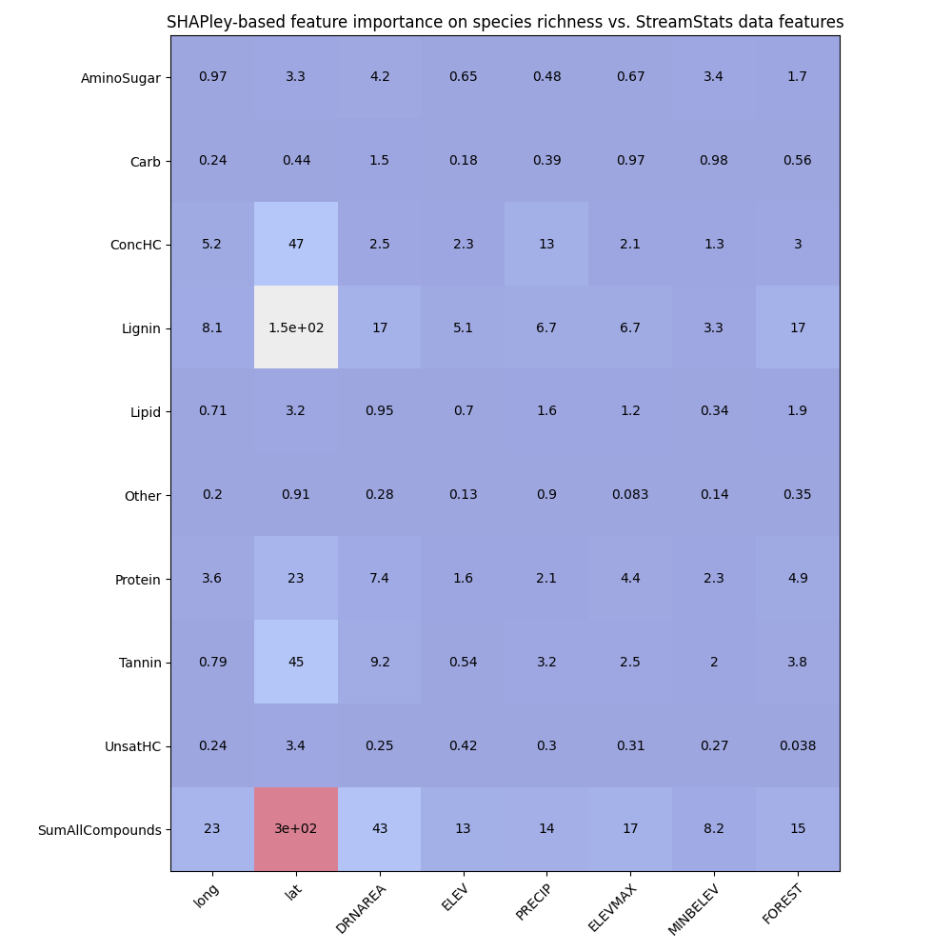
Feature importances using RF and SHAPley (StreamStats)

Slide 18
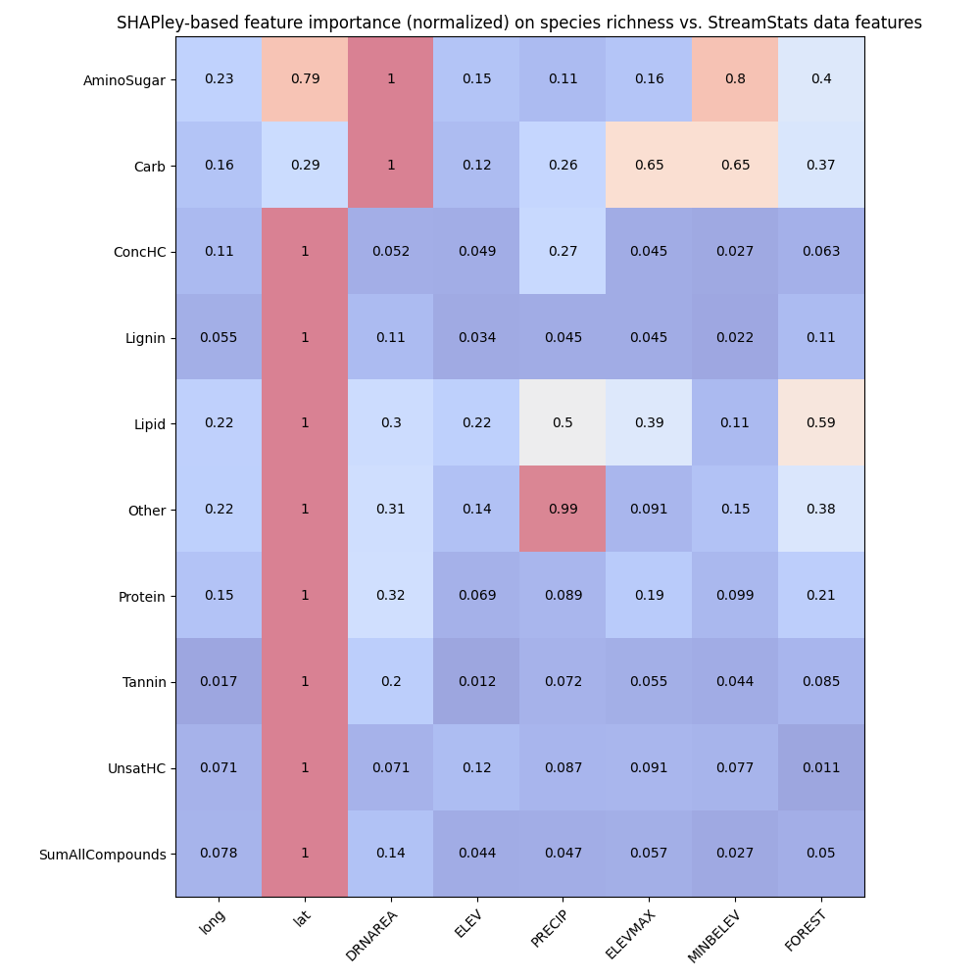
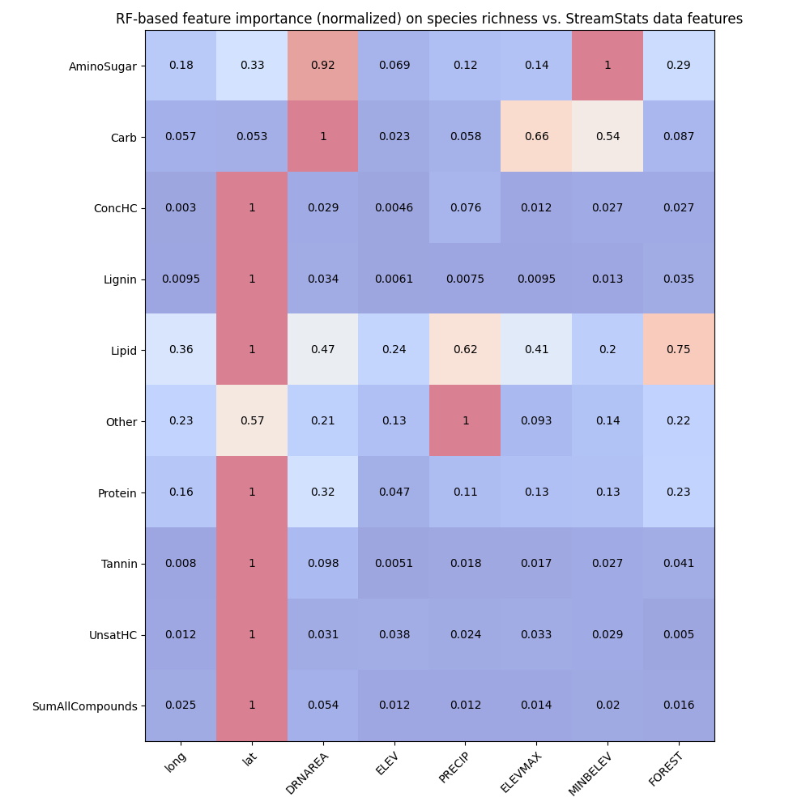
Feature importances using RF and SHAPley normalized (StreamStats)

Slide 19
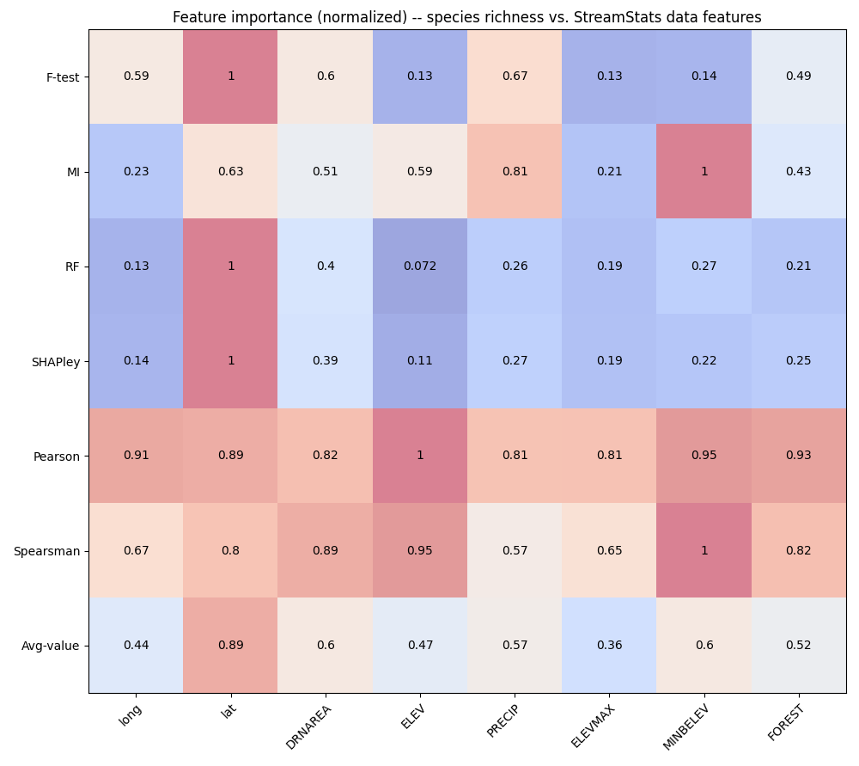
Feature importances among StreamStats variables
Behavior threshold for feature importance = 0.5
Min requirement = One feature shows a value > 0.5 among the feature importance methods
Latitude
Longitude
Drainage area
Minbelev (Min basement elevation?)
Precipitation
Forest cover?
Notes:
Citations for these statistical tests
Explain each of them and about what we discussed today
PCA analysis across WHONDRS, HydroSheds, StreamStats, and EPAwaters – On the extrinsic variables (grouping of variables – Local variables and landscape variables)
Landscape variables – HydroSheds, StreamStats, and EPAWatersheds
What a scaling plot would look like?

Slide 20
Feature importance among EPAWaters-Catchment variables
Metric/Descriptor of intrinsic variables
Species richness
This is estimated from the sample site data
Metrics/Descriptors of extrinsic variables
EPAwaters-Catchment data for these sites
Stream temperature, annual temperature
Land use land cover
Forest cover loss
Hydraulic conductivity
Feature importances → X: (all_samples, n_features); Y: (all_samples,)
Pearson correlation
Spearsman correlation
F-test
Mutual information (MI)
Random Forest (RF) with n_trees = 100
SHAPley values (based on RF model)

Slide 21
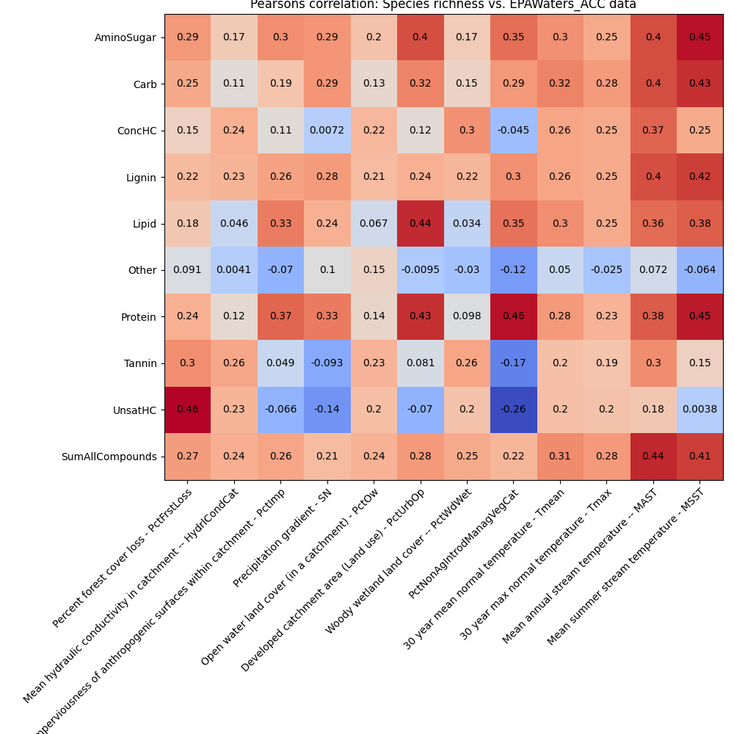
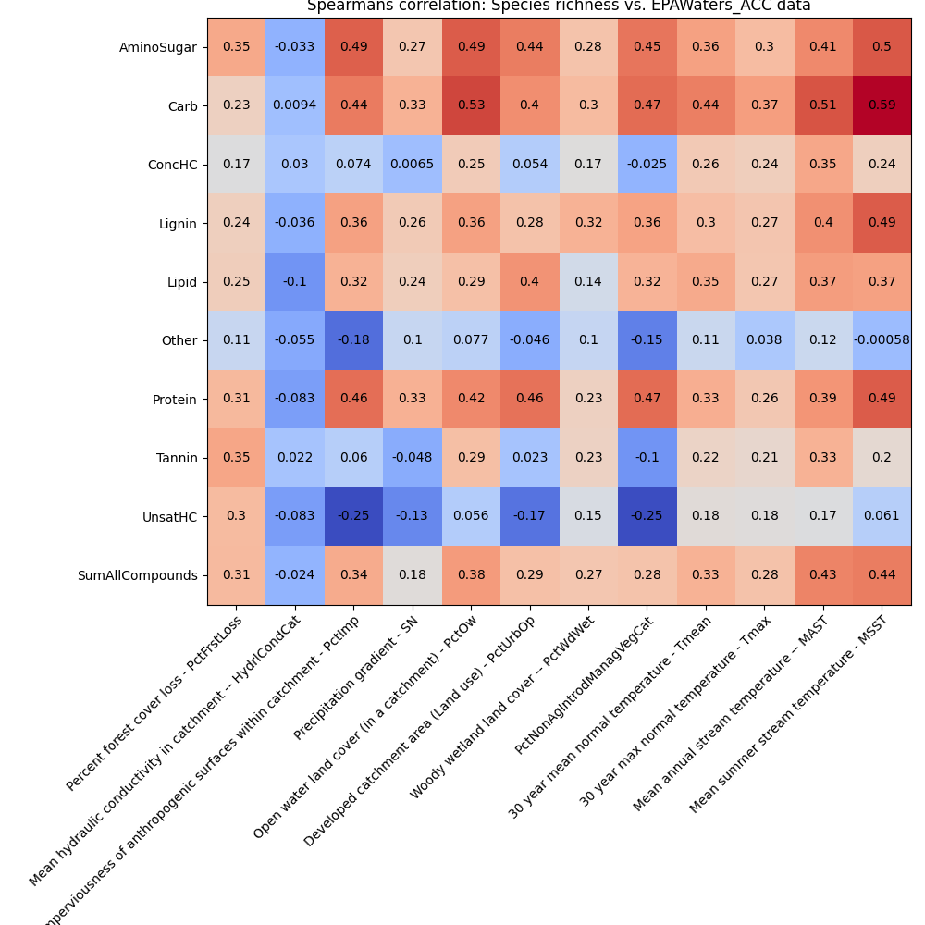
Feature importances – Pearsons and spearsman correlations (EPAWaters-Catchment)

Slide 22
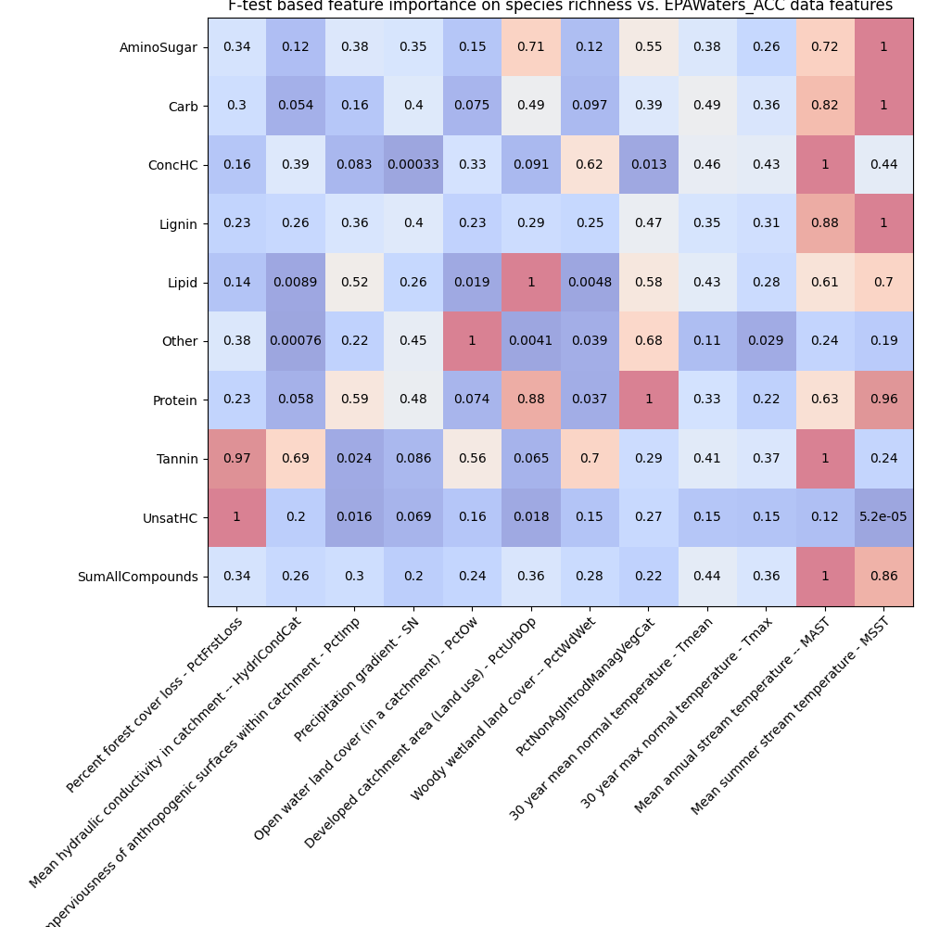
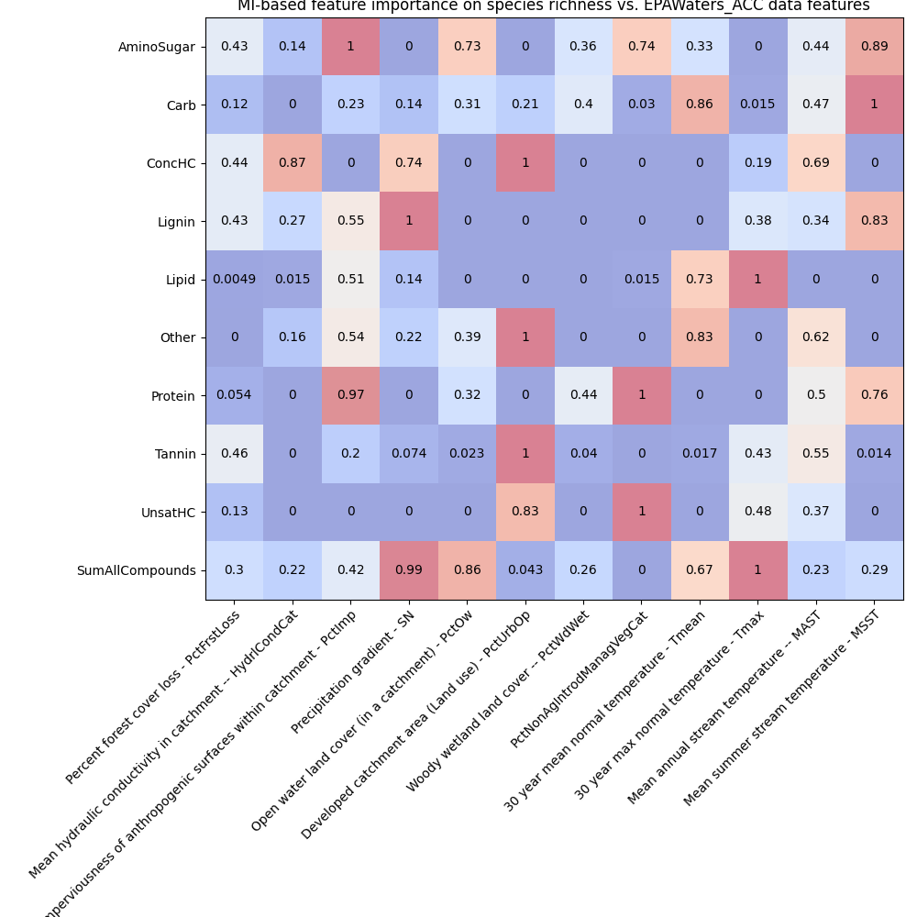
Feature importances using F-test and Mutual Information (EPAWaters-Catchment)

Slide 23
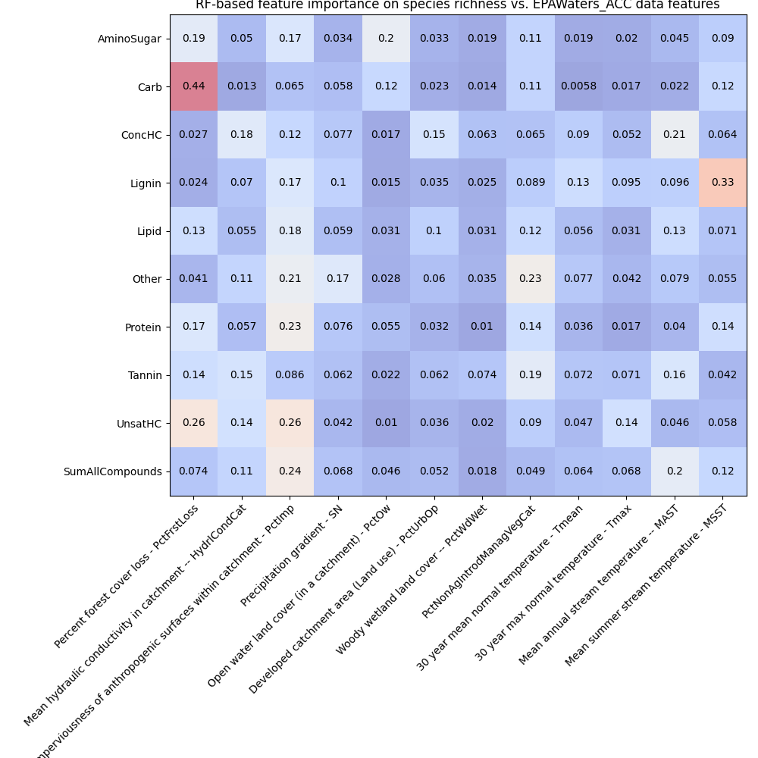
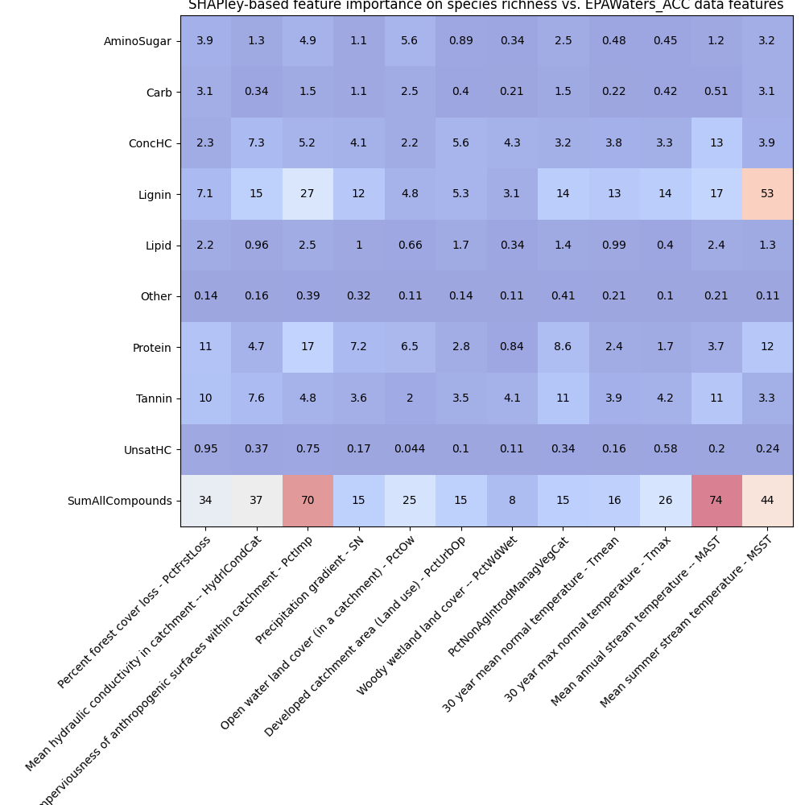
Feature importances using RF and SHAPley (EPAWaters-Catchment )

Slide 24
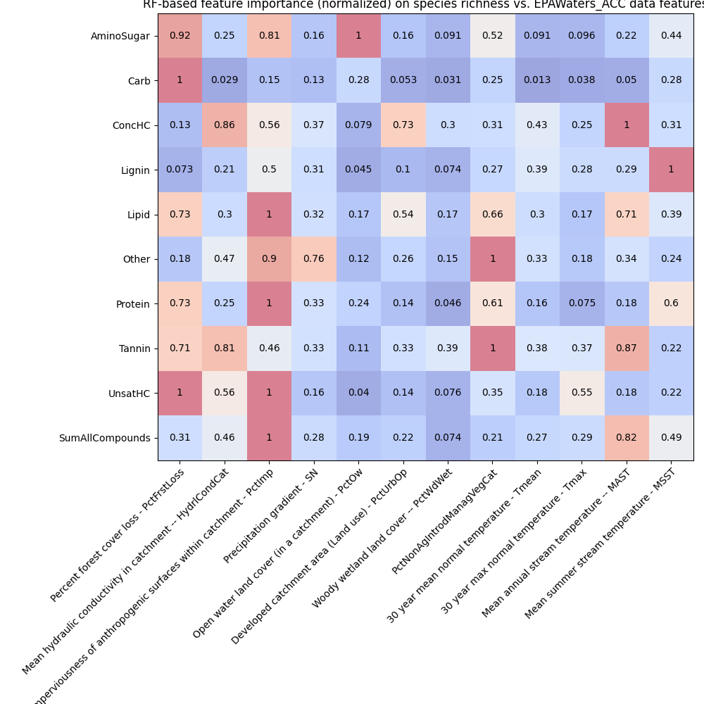
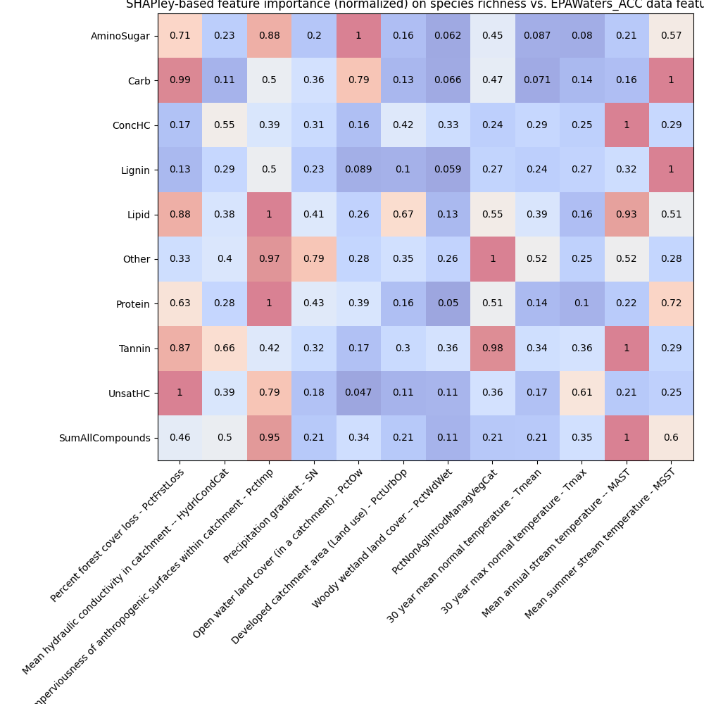
Feature importances using RF and SHAPley normalized (EPAWaters-Catchment)

Slide 25
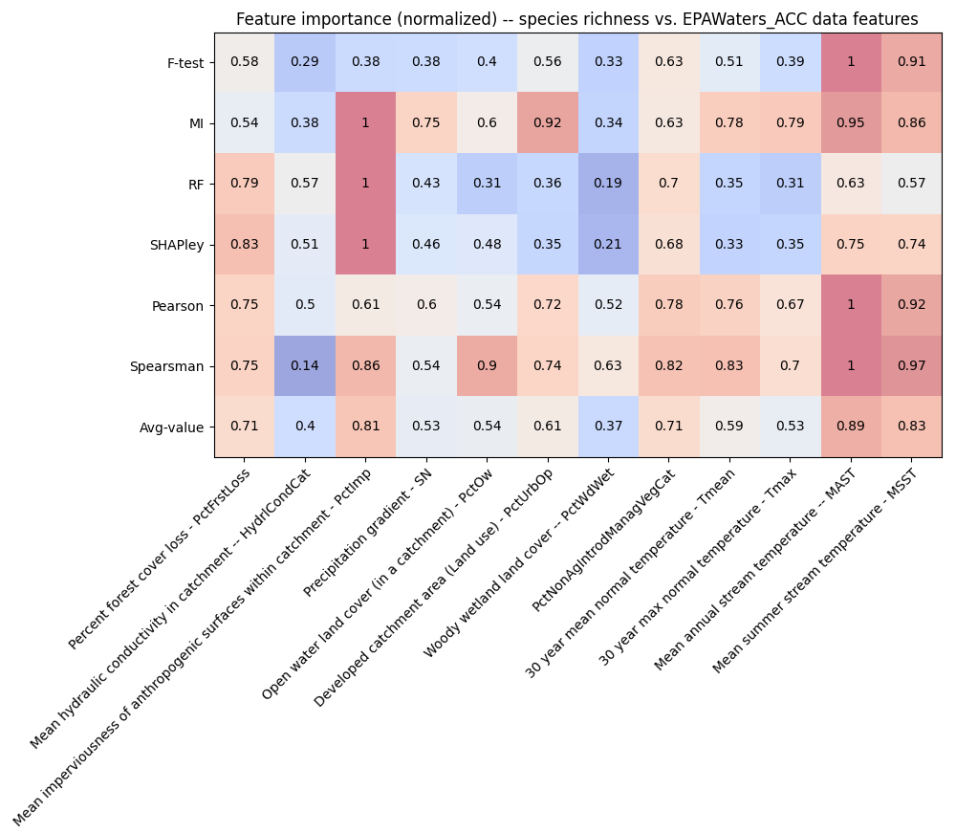
Feature importances among EPAWaters-Catchment variables
Behavior threshold for feature importance = 0.5
Min requirement = One feature shows a value > 0.5 among the feature importance methods
Stream temperature (summer, annual)
PctNonAgIntrodManagVegCat
% Nonagriculture nonnative introduced or managed vegetation landcover type reclassed from LANDFIRE Existing Vegetation Type (EVT), within catchment
Land use and land cover
Forest cover loss
Precipitation gradient
Notes:
Citations for these statistical tests
Explain each of them and about what we discussed today
PCA analysis across WHONDRS, HydroSheds, StreamStats, and EPAwaters – On the extrinsic variables (grouping of variables – Local variables and landscape variables)
Landscape variables – HydroSheds, StreamStats, and EPAWatersheds
What a scaling plot would look like?

Slide 26
Feature importance among EPAWaters-Watershed variables
Metric/Descriptor of intrinsic variables
Species richness
This is estimated from the sample site data
Metrics/Descriptors of extrinsic variables
EPAwaters-Watershed data for these sites
Watershed characteristics
Land use land cover
Forest cover loss
Feature importances → X: (all_samples, n_features); Y: (all_samples,)
Pearson correlation
Spearsman correlation
F-test
Mutual information (MI)
Random Forest (RF) with n_trees = 100
SHAPley values (based on RF model)

Slide 27
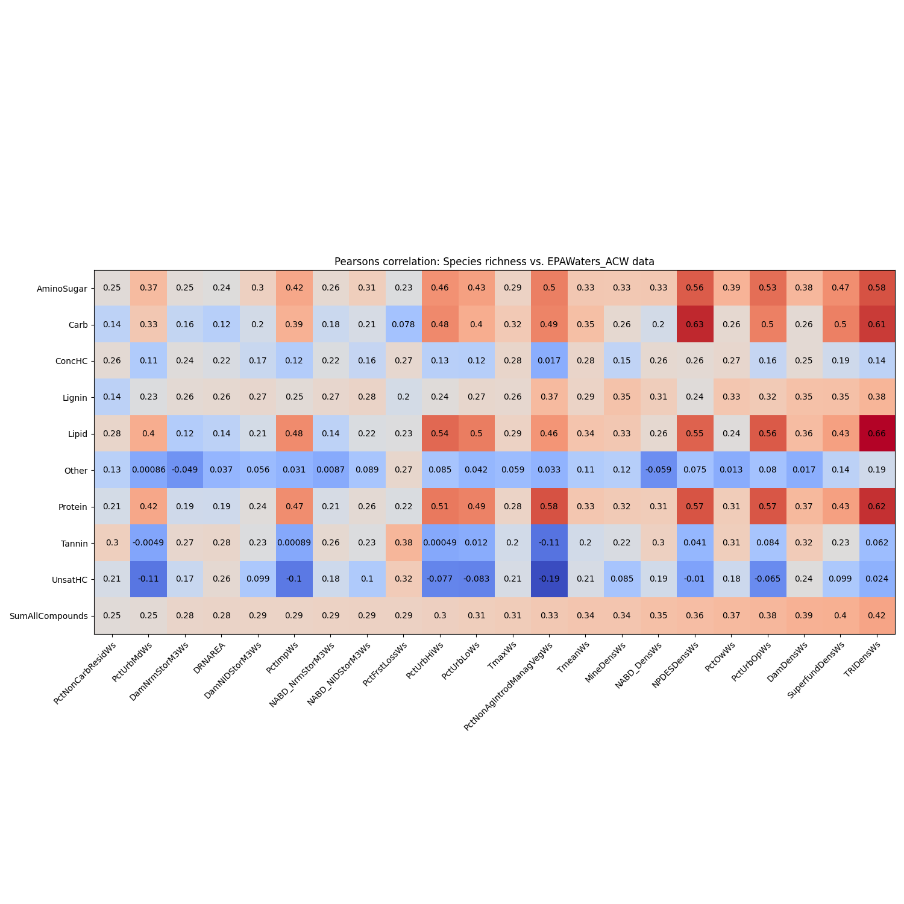
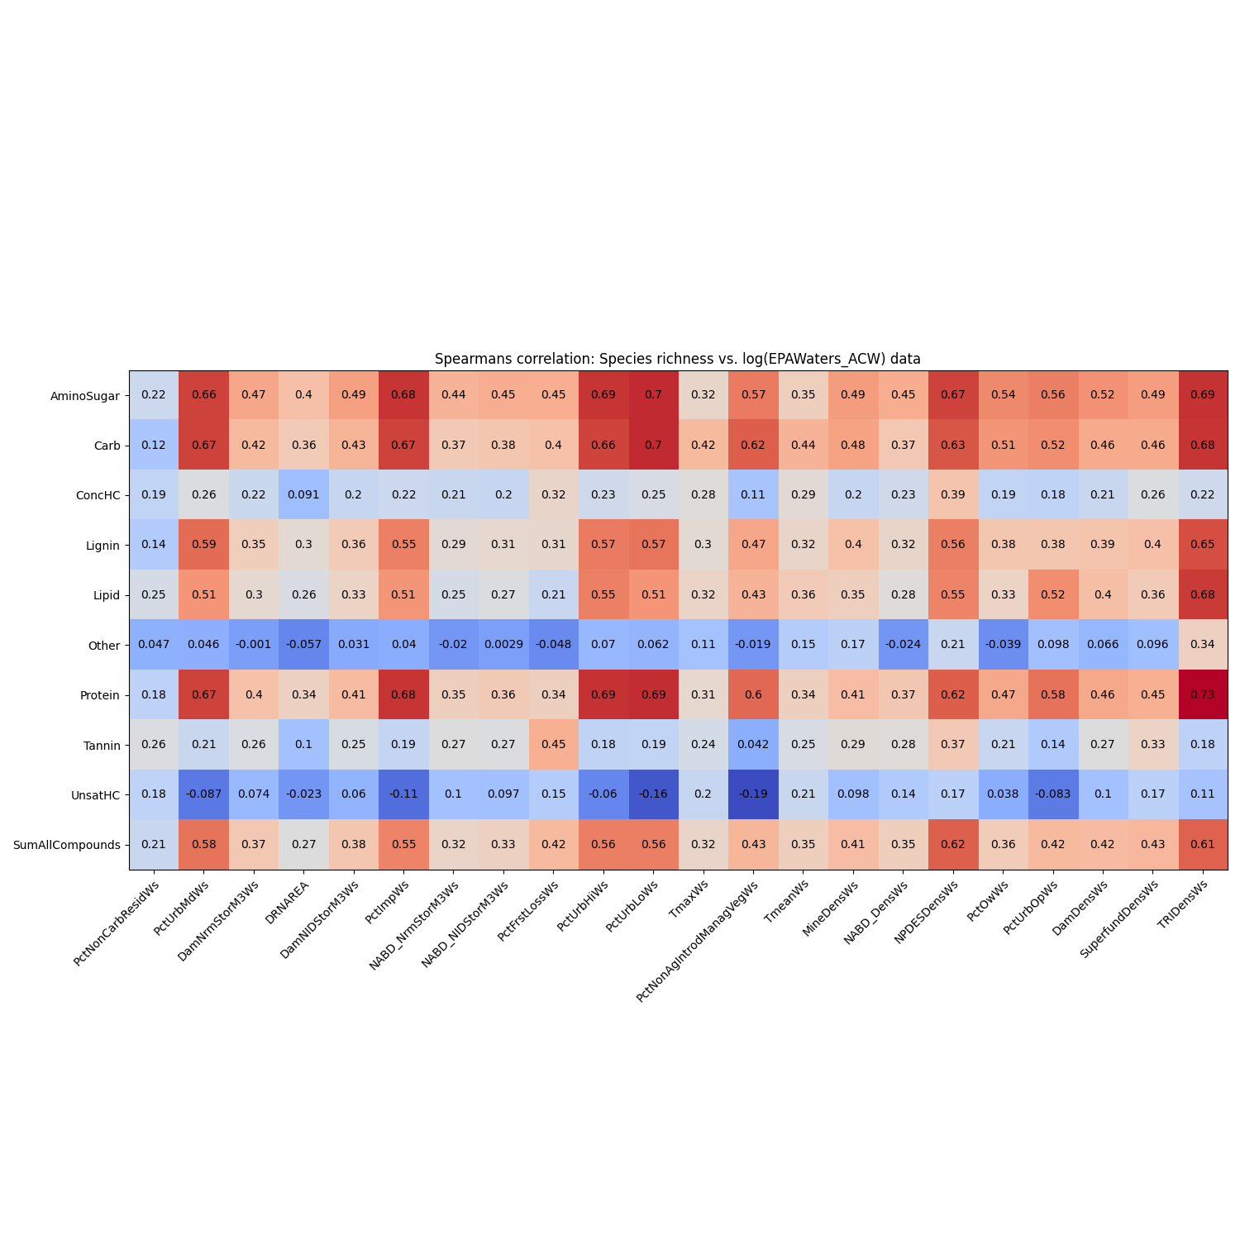
Feature importances – Pearsons and spearsman correlations (EPAWaters-Watershed)

Slide 28
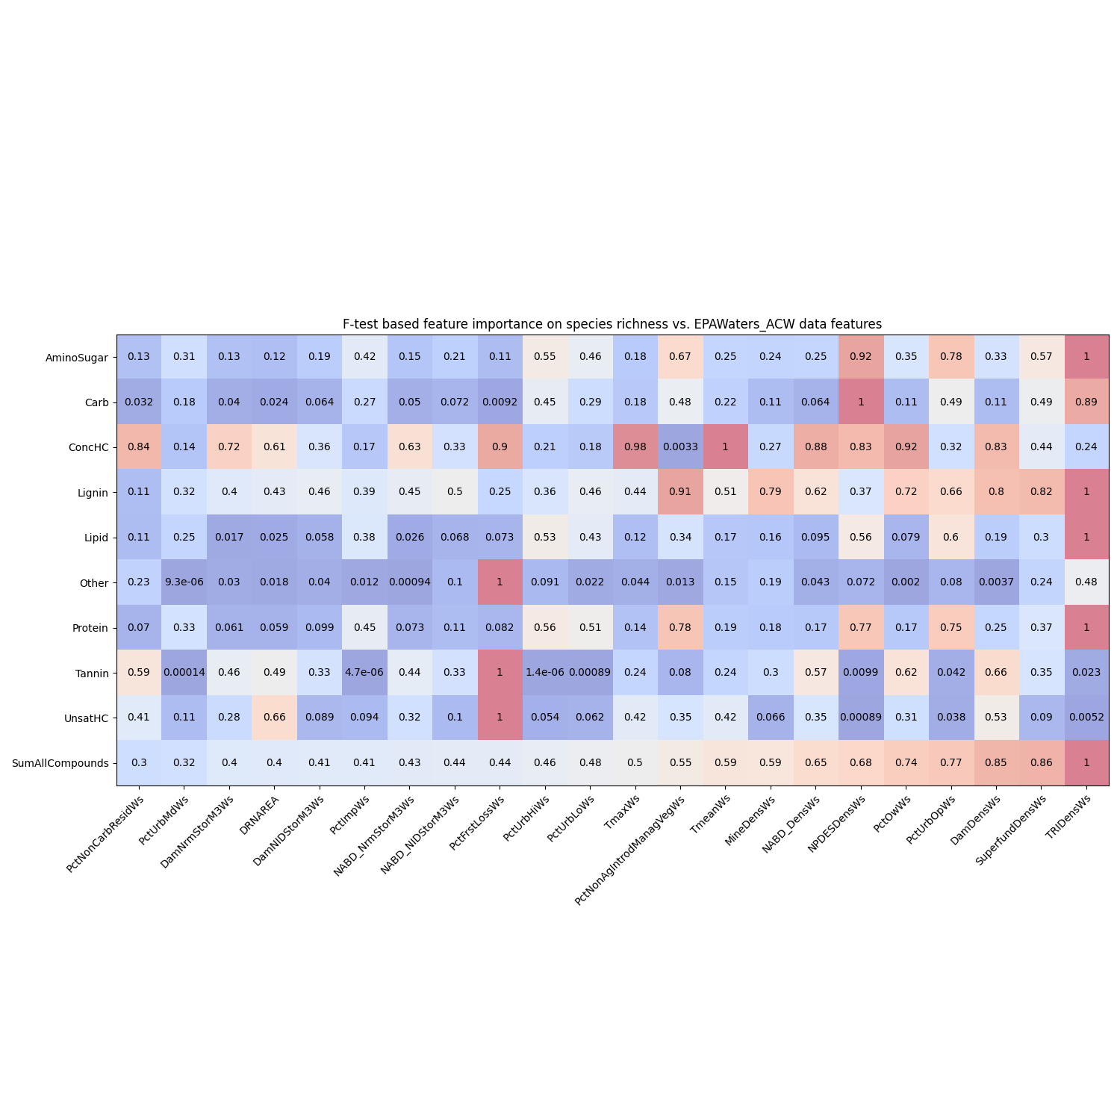
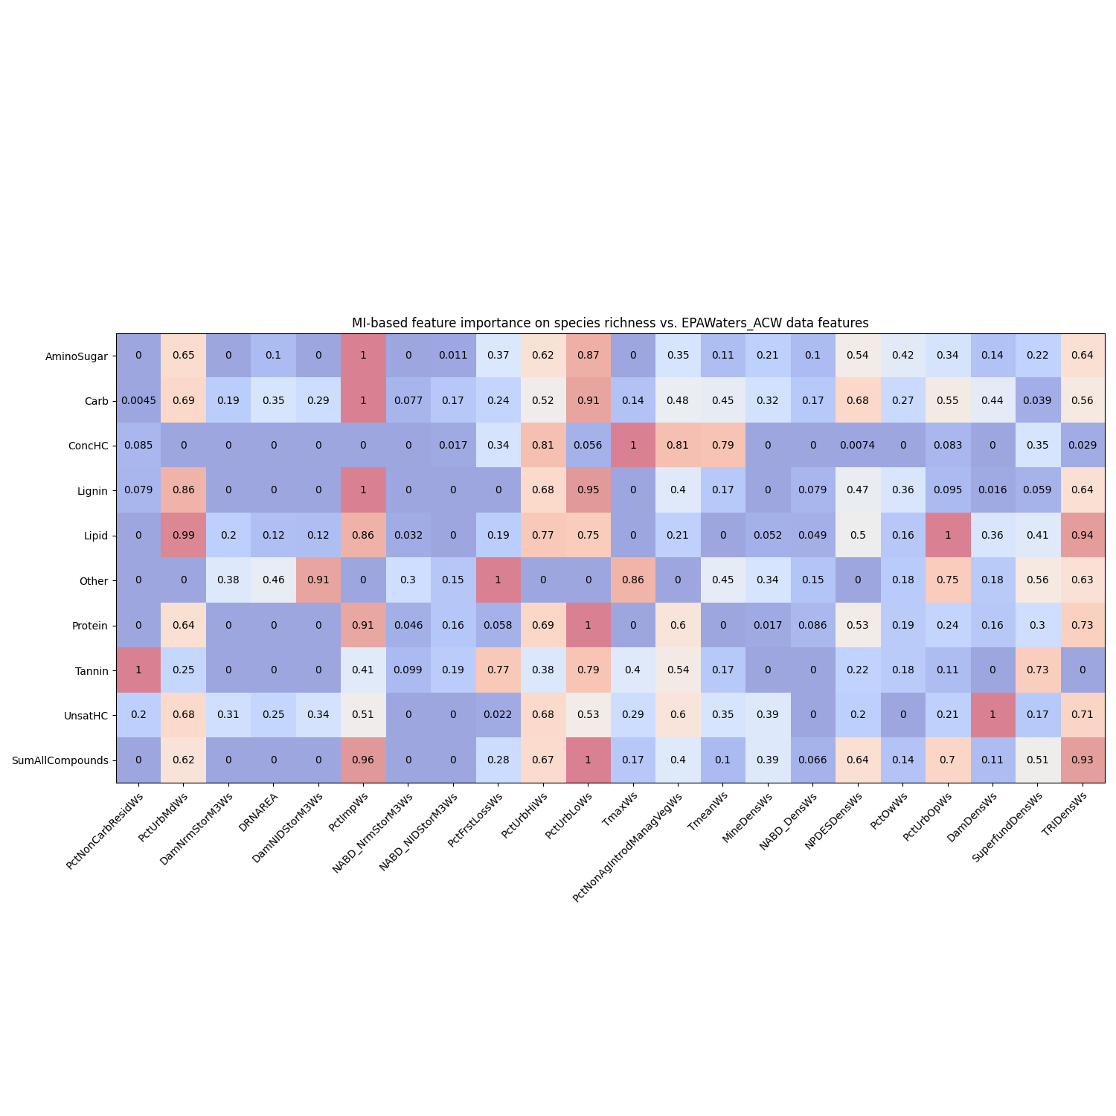
Feature importances using F-test and Mutual Information (EPAWaters-Watershed)

Slide 29
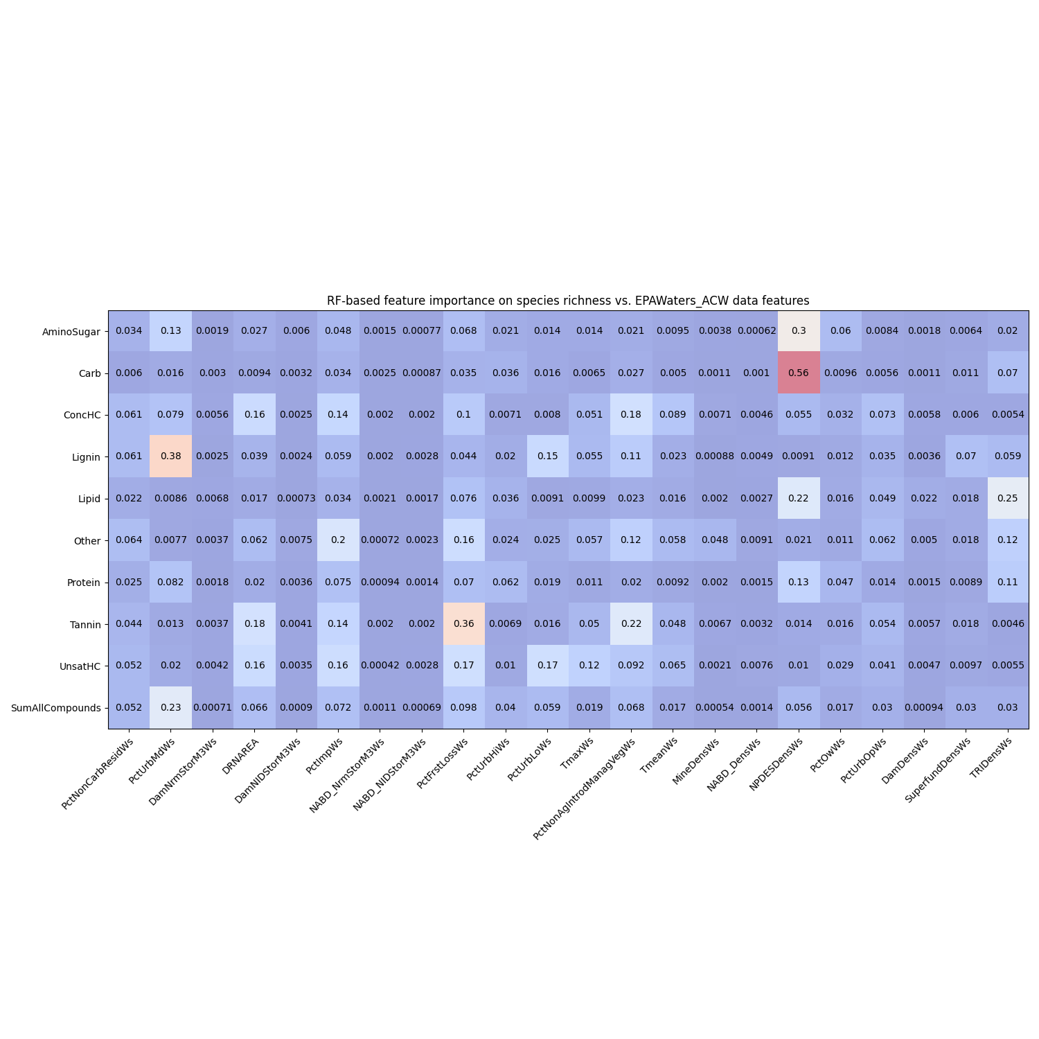
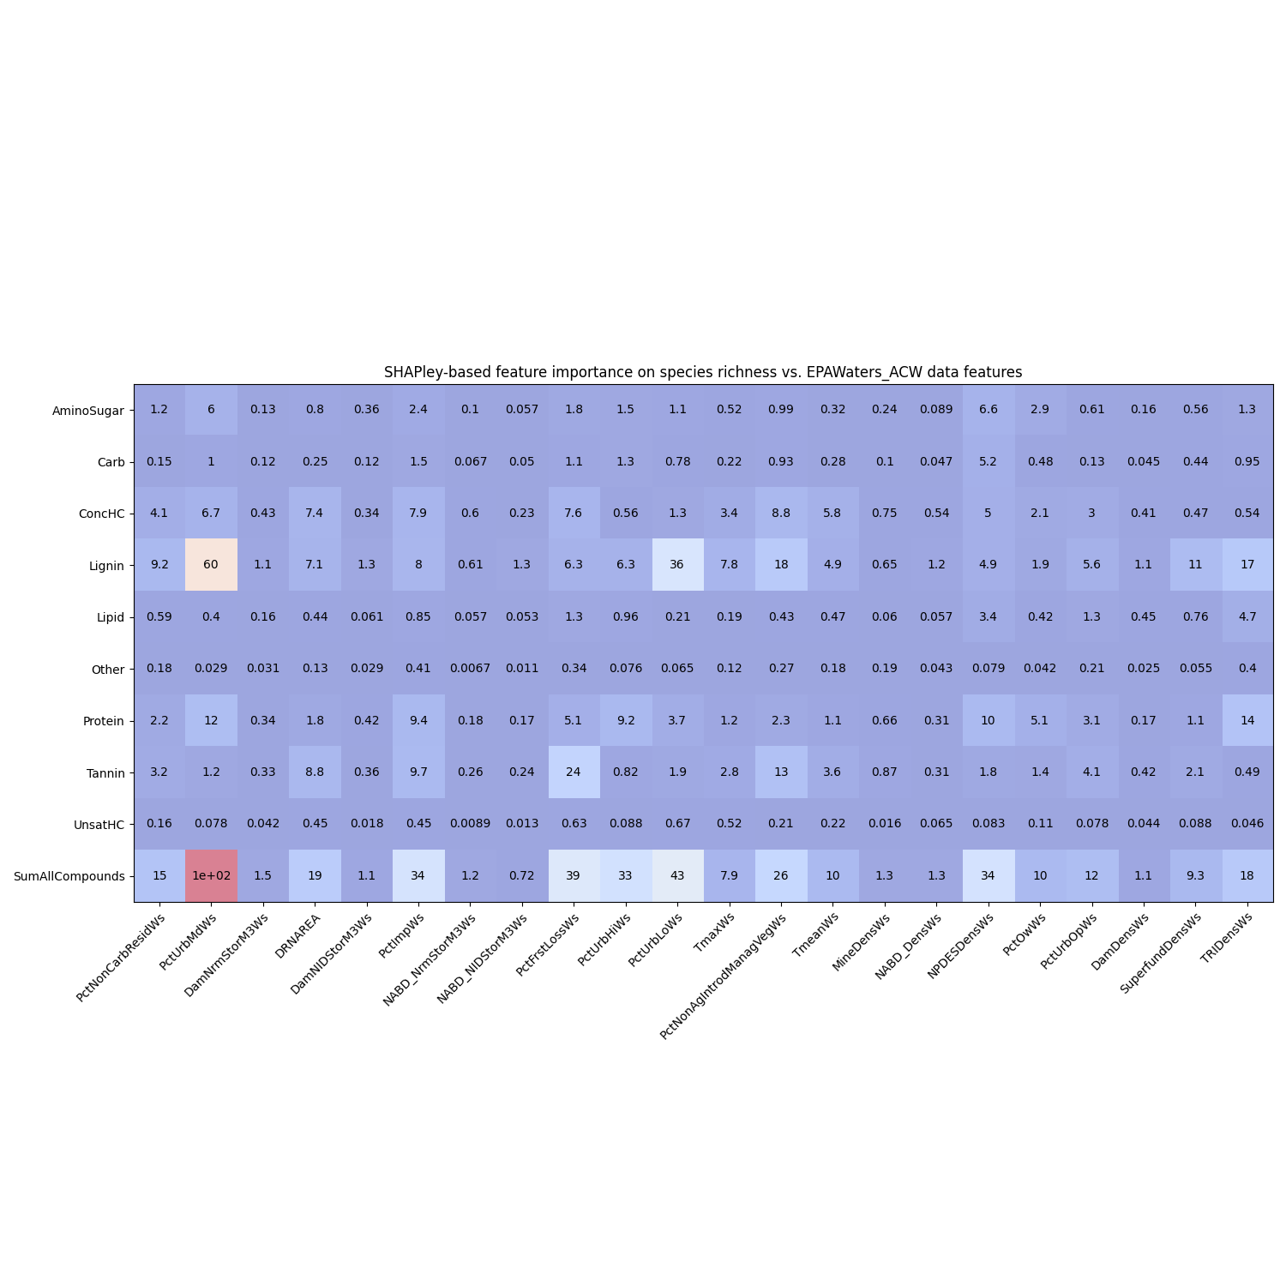
Feature importances using RF and SHAPley (EPAWaters-Watershed)

Slide 30
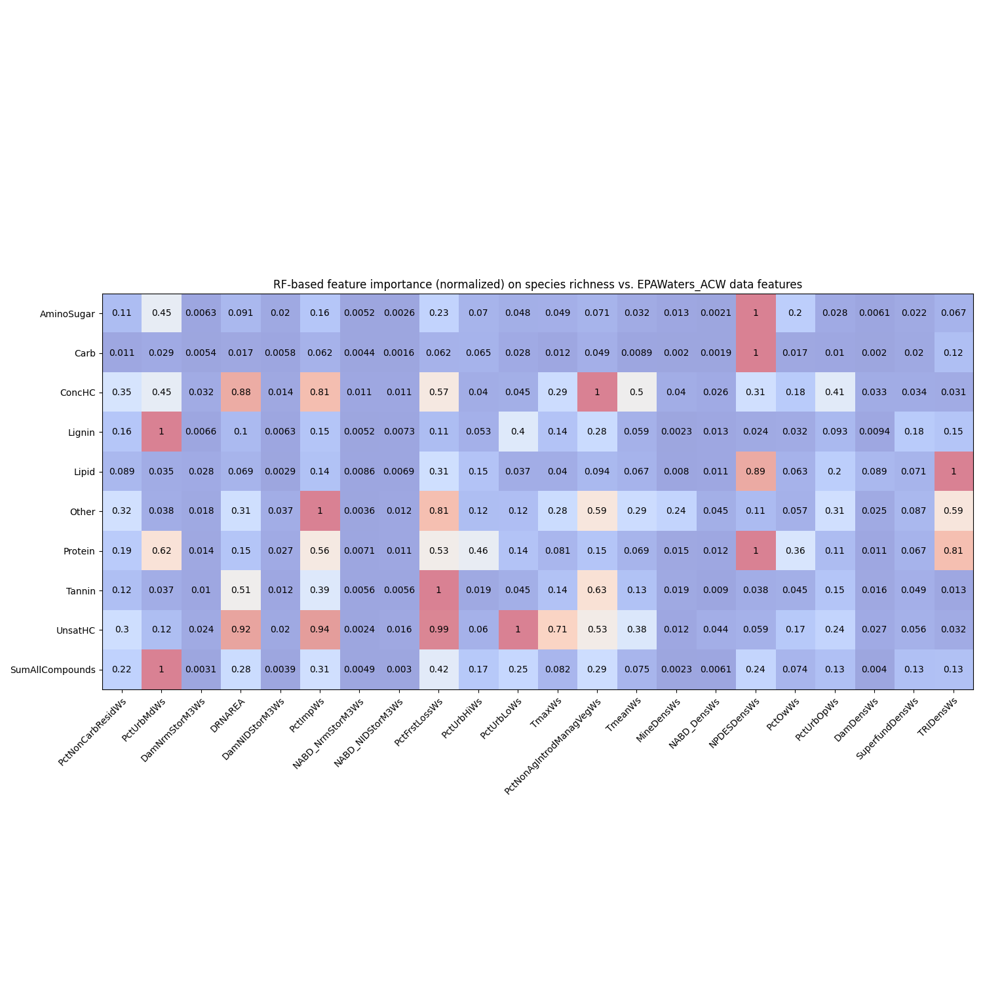
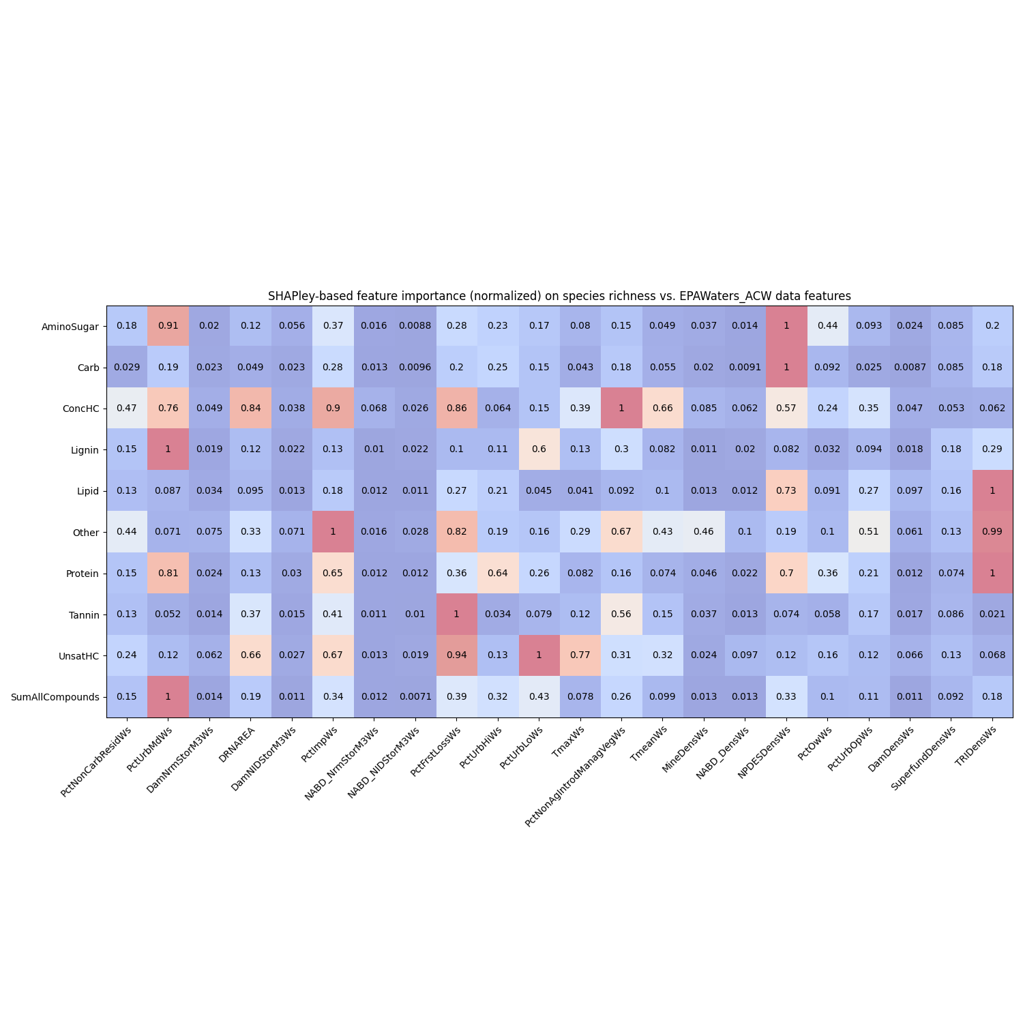
Feature importances using RF and SHAPley normalized (EPAWaters-Watershed)

Slide 31
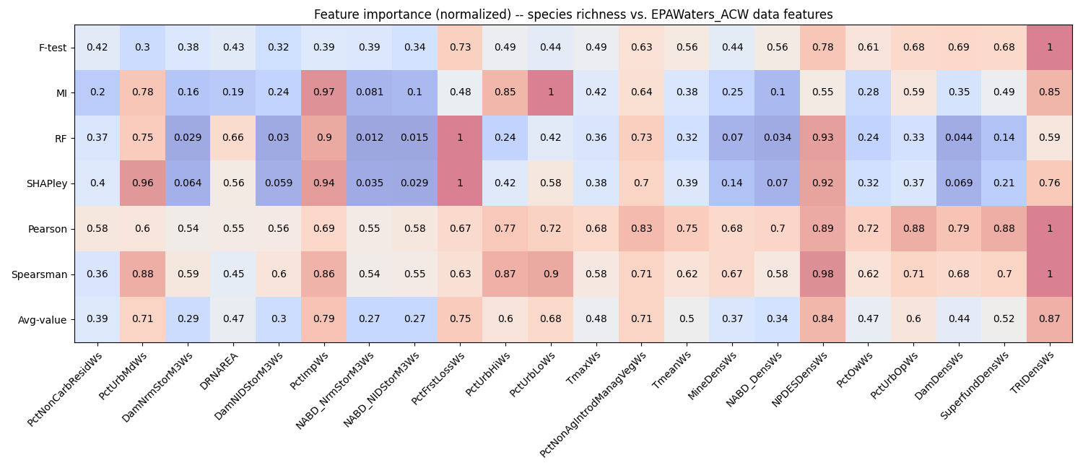
Feature importances among EPAWaters-Watershed variables
Behavior threshold for feature importance = 0.5
Min requirement = One feature shows a value > 0.5 among the feature importance methods
TriDensWs
Density of TRI (Toxic Release Inventory) sites within watershed (sites/square km)
NPDESDensCat
Density of permitted NPDES (National Pollutant Discharge Elimination System) sites within catchment (sites/square km)
PctNonAgIntrodManagVegWs
% Nonagriculture nonnative introduced or managed vegetation landcover type reclassed from LANDFIRE Existing Vegetation Type (EVT), within watershed
PcTUrbLo, PctUrbMd, and PctUrbHi
% of watershed area classified as developed, low/med/high-intensity land use
Percent of Forest loss
Mean imperviousness of anthropogenic surfaces within watershed
Drainage area
Notes:
Citations for these statistical tests
Explain each of them and about what we discussed today
PCA analysis across WHONDRS, HydroSheds, StreamStats, and EPAwaters – On the extrinsic variables (grouping of variables – Local variables and landscape variables)
Landscape variables – HydroSheds, StreamStats, and EPAWatersheds
What a scaling plot would look like?

